Slide 1



Children’s Health Scotland
Child Healthcare in Scotland: Overcoming the Challenges to Equality
Approaches and Challenges in addressing Children and Young People’s Health and Emotional Wellbeing.
SYP campaigns
By Chloé Robertson MSYP for Cunninghame South (Convener of the Health and Wellbeing Committee) and
Thomas McEachan MSYP for Glasgow Pollok (Trustee with portfolio for Projects and Campaigns).
Notes:
<Thomas>
Good afternoon everyone, and thanks so much to Children’s Health Scotland for having us here to speak on behalf of the Scottish Youth Parliament, or SYP, today. My name is Thomas McEachan MSYP for Glasgow Pollok, and I am a Trustee with portfolio for Projects and Campaigns at SYP. This is…
<Chloe>
Chloé Robertson MSYP for Cunninghame South, and I am the Convener of the Health and Wellbeing Committee at SYP.

Slide 2

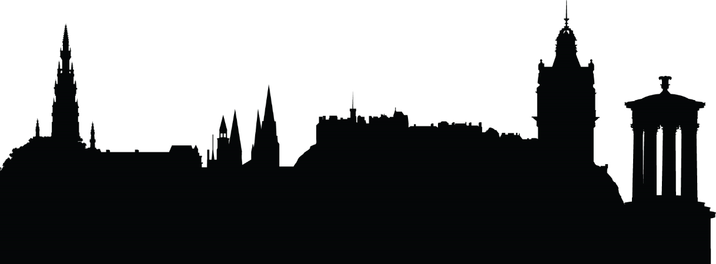
About SYP
The democratically elected voice of Scotland’s young people…
The Scottish Youth Parliament represents young people all over Scotland.
We were established on the 30th June 1999, making us one day older than the Scottish Parliament.
Elections are held every 2 years, and young people from all over Scotland can stand as candidates to become MSYPs.
We are fundamentally youth-led in all aspects
Our values: democracy, inclusion, impartiality and rights!
Notes:
<Thomas>
Today we’re going to present to you a bit about our campaigns, to provide a basis for our discussion on approaches and challenges in addressing children and young people’s health and emotional wellbeing. But first, let’s do a wee intro to SYP itself.
Briefly, we have two MSYPS elected every two years in each Scottish Parliament constituency. We have around 160 MSYPs at present, aged between 14 and 25 but representing the views of young people aged 12-25.
Every one of Scotland’s 32 local authorities supports SYP at present, something we are both very grateful for, and proud of, because it allows us to genuinely represent the views of ALL of Scotland’s young people.
We are a fundamentally rights-based organisation, and our mission, vision, and values are grounded in the United Nations Convention on the Rights of the Child (UNCRC). In particular, our purpose embodies Article 12: “Young people have the right to express their views freely and have their opinions listened to in all matters affecting them”.
As a completely youth-led organisation, the words and sentiment of Article 12 have profound importance for our work. For example, Chloé is a member of the Conveners Group, a group of democratically elected 10 young people who lead on SYP’s Policy and Campaigns.
Our democratically elected members listen to and recognise the issues that are most important to young people, ensuring that their voices are heard by decision-makers. We exist to provide a national platform for young people to discuss the issues that are important to them, and campaign to effect the change they wish to see.
Inclusion and diversity is very important to SYP, as well as political impartiality and rights… which we’ll come onto a little later.
We are very proud of how diverse our Membership is, and how well we reflect the communities of young people we serve across all of Scotland.

Slide 3

Notes:
<Thomas> Firstly, I’ll explain a little about SYP’s campaign from last year, which we chose to be about young people’s mental health. We see this as a big challenge to children and young people’s health and wellbeing.

Slide 4
Speak Your Mind
Increase awareness and understanding of mental health;
Encourage the use of a common language to promote positive conversations and tackle stigma;
Identify young people’s awareness and experience of mental health information and services;
Advocate for high quality mental health service and information provision for all young people
Notes:
Like all SYP’s work, this campaign was developed by young people. Its key objectives were:
To increase young people’s awareness and understanding of the issues associated with mental health;
To encourage the use of a common language in order to promote positive conversations and tackle stigma associated with young people’s mental health;
To identify young people’s awareness and experience of mental health information and services for young people across Scotland;
To advocate for high quality mental health service and information provision for all of Scotland’s young people, with supporting guidance on best practice for service providers.
We wanted to hear from young people themselves, and use their voices and experience to advocate for high quality mental health information, support, and services. So that’s really how our research came about.

Slide 5
Our generation’s epidemic
Notes:
MSYPs spent the first part of last year gathering responses from almost 1500 young people aged between 12 and 26 on their awareness and experience of mental health information, support, and services, making this piece of research one of the largest of its kind in Scotland. SYP staff also conducted focus groups with 30 young people.
1,453 young people responded to paper/online survey
30 young people took part in focus groups
One of the largest pieces of research of its kind in Scotland
These findings formed the basis of our report, Our generation’s epidemic, copies of which are available on our website and at the SYP stall here today.
This title came out of a discussion in one of our focus groups, when one of the participants noted that the huge number of young people facing mental health challenges is “our generation’s epidemic”.

Slide 6
Notes:
So, what did we find out?
The short answer is, a lot, and I don’t have time to go into too much detail today, so do read the report, which you can pick up at the SYP stall, to get the full picture.
However, to quickly highlight some of the key findings, the research shows that there is a worrying lack of awareness amongst young people about available information, support, and services.
74% of the young people who took part in the research did not know what mental health information, support, and services are available in their local area. Worryingly, of those who considered themselves to have experienced a mental health problem, 70% did not know what was locally available.
SYP’s research also found that one in five respondents do not know where to go for advice and support for a mental health problem. Young people also identified that, in addition to embarrassment and a fear of being judged, a lack of understanding about mental health is a major barrier to talking openly about mental health.

Slide 7
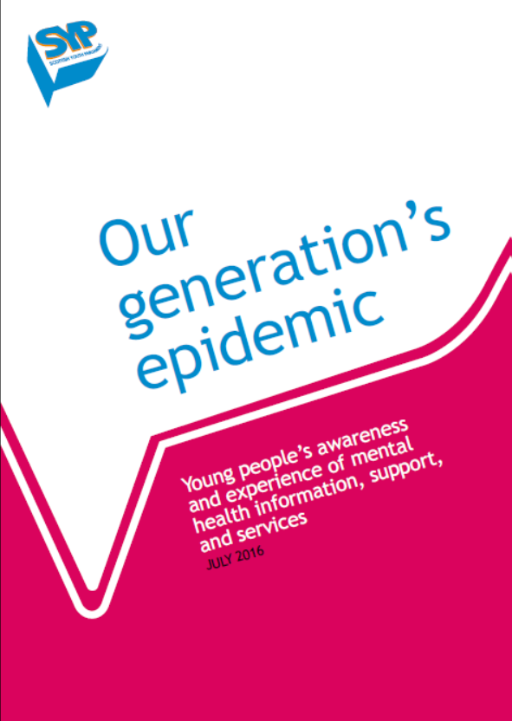
Notes:
In terms of experience of mental health information, support, and services, young people aged between 18 and 26 years old are less likely to find information about mental health young person-friendly than those aged between 12 and 17. Young people told us that they felt that public information about mental health should be tailored according to different age groups. It was very interesting to us that the older young people found this more of an issue than the younger group. This theme that the transitional age group of 18-26 having particular challenges and being a real group with significant unmet needs was a conclusion from our research that came up again and again.
When it came to support, 27% of young people do not feel supported to talk about mental health in their place of learning or workplace. We received many comments from young people about the lack of mental health education and support in schools, with a real feeling that mental health isn’t a priority in schools. Worryingly, 55% of those who took part in the research said they wouldn’t feel comfortable talking to a teacher about their mental health, with only 11% saying they would be comfortable.
Many of the young people we spoke to had experience of mental health services. They identified a range of challenges that they faced, including a lack of accessibility and confidentiality, not being taken seriously due to their age, and a lack of person-centred treatment.
Services that are young person-specific were identified as positive examples of mental health services, with young people saying they had positive experiences of services with staff trained in young people’s issues and taking a young-person friendly approach.

Slide 8
Our generation’s epidemic: key points from our recommendations
All schools, colleges and universities should provide high quality info about mental health, and consult young people about that info.
Every school and other place of learning should implement a Mental Health Action Plan.
Improve provision of school counsellors.
Greater spending on mental health of and support for 16 to 24 year olds, and focus on them in Mental Health Strategy.
Greater proportion of spending on preventative and early intervention support.
Develop a young person led mental health and wellbeing forum in every local authority.
Notes:
So, those were the main issues that we identified, but we also came up with some recommendations as well.
On this slide, we have highlighted some of the ones that we felt that you might be able to help us deliver – these are in the report too.
At a local level, we provided MSYPs with a Campaign Action Plan that will give them a set of resources to campaign for improved service provision and support in their local area → please give the Courtney Gemmell case study!
At a national level, we engaged with Scottish Government Ministers, including the Deputy First Minister and the Mental Health Minister, officials, MSPs from all of the parties, as well as national bodies like NHS Education Scotland, Education Scotland, and COSLA.

Slide 9
Impact
Influenced the Scottish Government’s Mental Health Strategy.
Secured agreement that CAMHS services should be extended from 18 yrs old to 25yrs old.
Persuaded Government to review PSHE in schools, focussing on mental health.
Influenced Scottish Conservatives MH policy document.
Mentioned in numerous PQs, motions etc.
Lots of local examples from across Scotland.
Encouraged young people to Speak Your Mind! – talk about mental health without stigma.
And many more!
Notes:
So- given all that, what did the campaign achieve?
The campaign managed to ensure young people influenced the Scottish Government’s Mental Health Strategy, as well as securing agreement that CAMHS services should be extended from 18-25 years old. Culturally, we triggered many conversations around mental health without stigma, which has brought about other campaigns such as SAMH’s Going to Be campaign, which we fully support! It’s great to be here today to continue these positive conversations around young people’s mental health and wellbeing.
We are still continuing work on mental health, in taking part in discussions such as this today, carrying on the conversation at a local level in schools and with councillors and MSPs, and continuing to influence the Mental Health Strategy. For example, we’re currently embarking on a project to improve transitions from children’s mental health services to adult mental health services and looking into anticipatory care planning with the Scottish Government. Please follow our Twitter to find out more @OfficialSYP.
We can also look at mental health and rights with our new campaign, so I’ll hand you over to Chloé now to tell you more about it!

Slide 10
Notes:
<Chloé>
I’m now excited to introduce you all to SYP’s new national campaign on young people’s rights, which launched just over a week ago, entitled Right Here, Right Now. MSYPs consulted with over 5,000 young people.
This campaign will run until October 2018. Campaigns are selected by MSYPs, and this year young people’s rights was selected at the Sitting in June after MSYPs consulted with over 5,000 young people.
We are currently working with a range of partner organisations some of whom are here today and who have helped to steer the direction of our campaign.
One of the key things our campaign is about is not solely focussing on the UN Convention on the Rights of the Child (UNCRC). In most cases, the UNCRC covers young people up to the age of 18. As SYP represents young people up to the age of 25, this campaign will look wider than just the UNCRC, to ensure this older age group is recognised, and to give MSYPs representing national voluntary organisations a greater role in campaign activities than has been possible in previous SYP campaigns.

Slide 11
Key messages
By the end of this campaign, SYP wants:
Scotland’s young people to be aware of and understand their own rights, and be empowered to take action to defend their own rights and those of others.
Scotland’s decision-makers to take a human rights-based approach to all policy-making, service provision, and planning, ensuring young people’s voices are at the heart of decisions affecting them.
Notes:
The key campaign messages of Right Here, Right Now will have both a local and a national focus, concentrating on strengthening the protection of young people’s rights in Scotland; reinforcing the links between MSYPs and local decision-makers, and between SYP and national institutions; and empowering young people to defend their own rights and the rights of others.
By the end of this campaign, SYP wants:
• Scotland’s young people to be aware of and understand their own rights, and be empowered to take action to defend their own rights and those of others.
• Scotland’s decision-makers to take a human rights-based approach to all policy-making, service provision, and planning, ensuring young people’s voices are at the heart of decisions affecting them.

Slide 12
Campaign Objectives
To influence law, policy, and practice in order to strengthen the protection of young people’s rights.
To improve links between SYP, public bodies, and national institutions, such as the Scottish Parliament, to respect, protect, and promote young people’s rights.
To promote young people’s rights, and empower individuals to defend their own rights and those of others.
To strengthen and enhance the status of MSYPs as the voice of Scotland’s young people at a local level, and to strengthen the role of voluntary organisation MSYPs nationally.
Notes:
The objectives of this campaign are closely related to the campaign themes, which I’ll talk about shortly, and the key messages. As such, the objectives of Right Here, Right Now are:
• To influence law, policy, and practice in order to strengthen the protection of young people’s rights.
• To improve links between SYP, public bodies, and national institutions, such as the Scottish Parliament, to respect, protect, and promote young people’s rights.
• To promote young people’s rights, and empower individuals to defend their own rights and those of others.
• To strengthen and enhance the status of MSYPs as the voice of Scotland’s young people at a local level, and to strengthen the role of voluntary organisation MSYPs nationally.
Each objective has a set of outputs and outcomes, which are outlined in the campaign strategy, and all of the campaign plans are designed with the goal of achieving these.

Slide 13
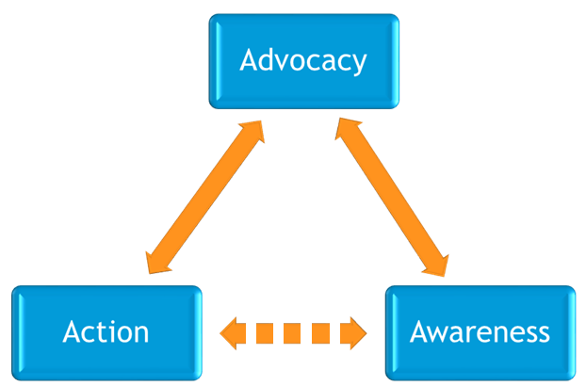
Campaign themes
Notes:
<If short of time Chloé, just give the short descriptions of the themes and choose a couple of examples of activities under each heading>.
Given the complex and wide-ranging scope of young people’s rights, there are many areas this campaign could focus on. Following conversations with the Conveners Group and partner organisations, it was agreed that this campaign will focus on three main themes:
• Advocacy
This is the overarching campaign theme, aiming to influence law, policy, and practice in order to strengthen the protection of young people’s rights. The key activities in this theme will focus on:
Calling for the incorporation of UNCRC into Scots Law.
Advocating for a rights-based approach to local and national decision-making, service provision, and planning – SYP will be working with Together Scotland to create resources for MSYPs to use locally to promote positive ways in which public bodies can do this, which will launch in early 2018.
Calling on the Scottish Government to produce a Children and Young People's Rights National Action Plan, and ensuring young people's views are at the heart of the Scottish Government's 2018 report on the current state of children and young people’s rights.
Defending the rights of young people during Brexit negotiations.
Persuading MSPs and others to support legislative and policy mechanisms, such as the Equal Protection Bill and Period Poverty campaign, to prevent breaches of young people's rights in Scotland.
• Action
Focussing on Article 12 of the UNCRC, this theme will seek to strengthen and enhance the status of MSYPs at a local level and within national voluntary organisations, and improve the links SYP has with other institutions, such as the Scottish Parliament.
SYP and individual MSYPs embody Article 12 of the UNCRC - the right for young people to have their views heard.
The main activities in this theme will focus on building links with local decision-makers by encouraging them to sign a pledge and commit to working more closely with the MSYPs in their areas. In December, SYP will be running a national week of action – Rights Week – with MSYPs carrying out lots of activities locally to raise awareness of SYP and MSYPs amongst constituents. There will also be a toolkit for NVO MSYPs to deliver their own mini-campaigns, focussing on a specific issue relating to the rights of young people in the organisation they represent.
• Awareness
Promoting young people’s rights to young people and those responsible for upholding these rights. It is essential that this campaign prioritises empowering young people to take action to realise, promote and defend their own rights and the rights of others.

Slide 14
Q&A
If you have any further questions, please contact Laura Pasternak, SYP’s Public Affairs Officer at laura.p@syp.org.uk
Notes:
This campaign comes at what we feel is a key and watershed moment for children and young people’s rights in Scotland. We’ve seen the commitment to exploring incorporation in the Programme for Government, as well as support for equal protection which we’ve been campaigning for. There’s still much work to be done, of course, in the area of mental health and rights, as well as the rights for 16 and 17 year olds to vote in UK elections, and combatting mosquito devices, to name a few areas in which we’re actively promoting young people’s rights. If anything comes out of this campaign, the empowerment of children and young people to be human rights defenders, and encouraging others to be too, is something we’re really hoping to achieve.
We’re delighted to be here today to learn more about the work of Children’s Health Scotland. We recognise and applaud all the work you do to promote child healthcare rights to children, young people, their families and practitioners, and we want to support and amplify the work you already do. We are delighted to join you in advocating a human rights based approach to healthcare provision for sick children and young people, based on Participation, Accountability, Non-discrimination, Empowerment, and Legality.
If you’d like to support us in our campaigning efforts, please come and speak to us today, or get in touch with us on our website.
<Thomas> That’s it from us, but we look forward to responding to your questions in the Q&A session. Thanks for listening.

