Slide 1
Approaches and challenges in meeting Children and Young People’s Health and Emotional Wellbeing
A school approach

Slide 2
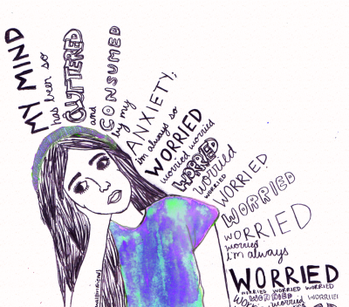
“A Child’s mental health is just as important as their physical health and deserves the same quality of support. No one would feel embarrassed about seeking help for a child if they broke their arm – and we really should be equally ready to support a child coping with emotional difficulties “
            Kate Middleton

Slide 3
Learning Intention
Whole school approach to addressing Health and Emotional Wellbeing
School as a caring community
Approaches and challenges in supporting those young people who are experiencing difficulties or are more vulnerable

Slide 4
S3 PSHE Programme – Session 2016-17
Week
1 | Introductory Lesson
2-5 | Taking Responsibility
6-7 | Personal Safety
8-12 | Knife Crime
13-14 | Relationships
15-17 | Drugs
Week
18-20 | Parenting
21-22 | Careers
22-25 | Course Choice
26-30 | Sexual Health
31-34 | Mental Health
35-40 | Study Skills

Slide 5
Challenges
Preferable to work in smaller groups (targeted intervention)
Resource implication (differentiated materials)
Time
Financial constraints
Re-structuring / timetabling implications
Class cover
Buying in resources to meet holistic needs

Slide 6
The Caring Community
Why bother?
Academic results (focus on attainment) versus personal development
A whole school vision will help develop self confidence, self esteem, develop resilience and equip young people with skills that are essential in working towards the type of academic success that is a true reflection of their ability. But more importantly they will also equip them with a greater sense of emotional wellbeing.

Slide 7
How schools identify young people with emotional vulnerability
Attendance concerns
Observations – isolation/withdrawn
Drop in academic performance
Wellbeing concern referrals covering SHANARRI indicators
Staff referrals
Self referrals All come from a caring community ethos
Peer referrals

Slide 8
How do we support these pupils
Universal and targeted intervention
1-1 support
Smaller (targeted) group work
Referrals to in-house support (Pupil / School Support Workers)
Listening / Counselling Service
Inter-agency collaboration / intervention
Staged intervention meetings

Slide 9
Family Support
Pupil Support workers
School Nurse
Community Learning and Development
Education Psychologist
CAMHS
Outreach
Barnardo’s
Speech and Language
Penumbra
SCRA
Medical
Anxiety
School Refusal
Family situations
Sexuality
Community Situation
Child or Young Person

Slide 10
Factors important in supporting Mental and Emotional Wellbeing
A strategy that includes specialist partnership engagement
Links, contacts and personnel involved have a real impact on young people
Skills Building, small group work and 1- to -1 make the real difference
Costly in time and staffing, but effective in helping to address mental and emotional wellbeing

