Slide 1
End of life care for neonates
Evelyn Rodger Diana Children’s Nurse

Slide 2
Neonatal Palliative care
Evolving speciality
Improves the care for the baby
Improves the experience for the family
Improves bereavement care
Improves staff experience

Slide 3
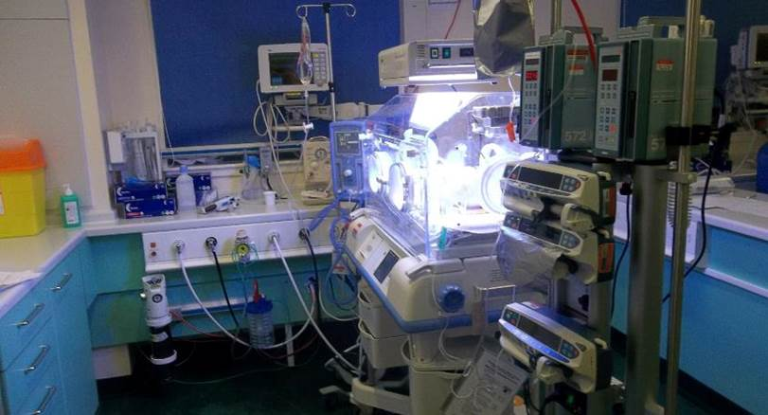
15 neonatal Units in Scotland
8 provide Intensive care

Slide 4
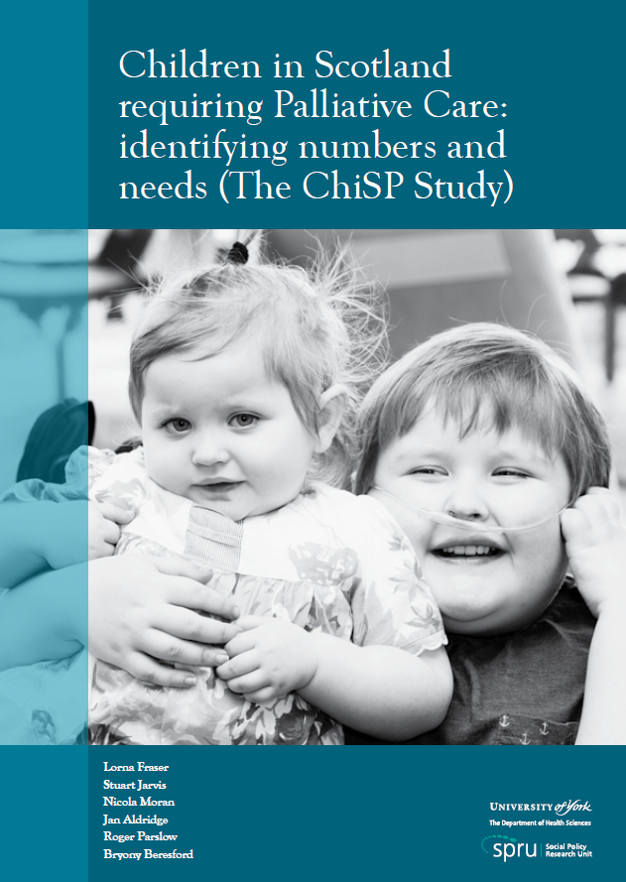
ChiSP 2015
15,404 children and
Young people living in
Scotland with life-limiting
Conditions
4,783 children under 5 years

Slide 5
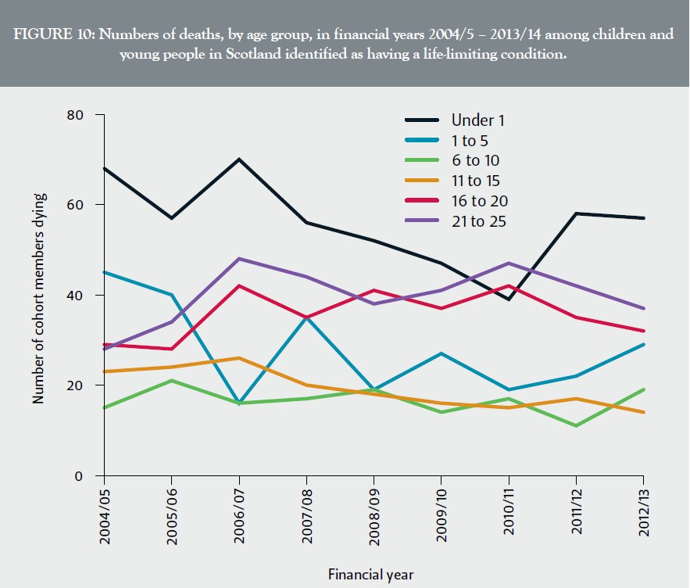
Number of deaths
“Children under
1 year of age
Should be seen
As a priority
Group for
Input from
Palliative care
Services”

Slide 6
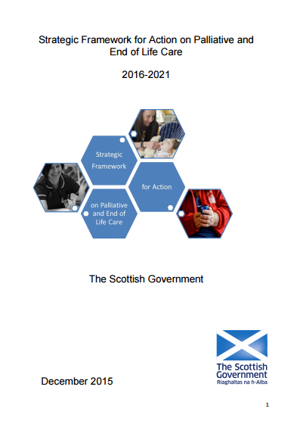
Frameworks
“ Support and promote
The further development
0f holistic palliative care
For the 0 -25 years age
Group”

Slide 7
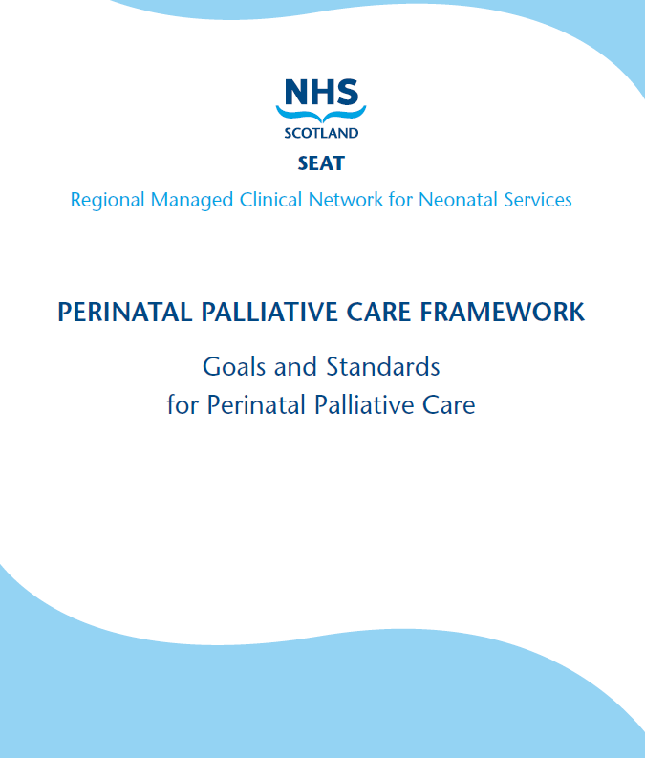
Perinatal Framework 2013
Earlier identification
(Antenatal period)
Anticipatory care planning
Choices available
Family wishes
Family and sibling support
Care during and after death

Slide 8
CHAS Plan 2017-2020
“Two thirds of the babies, children and young people who die from a life shortening condition each year in Scotland are not known to CHAS and do not get the benefit of our specialist support. We believe this must change”

Slide 9
How can we reach more…..
Diana Children’s Nurse (June 2014)
Family support into NICU (2014/15)
Joint Consultant Post (2016)
Access to wider CHAS team
Collaborative working with NHS colleagues

Slide 10
Key Learning:
Enhanced memory making
Sibling support
Emotional support
Social support

Slide 11
Memory making before death
Sibling Involvement
Choice of place of death

Slide 12
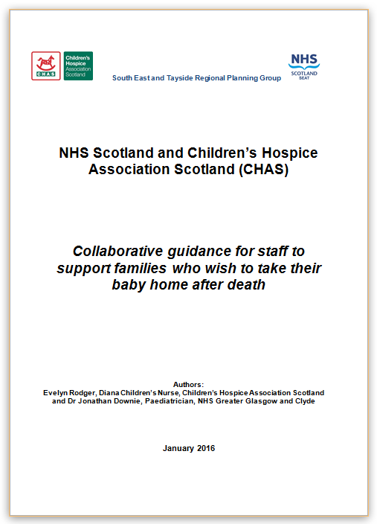
Post death care
Offering choice
Collaborative working
Communication
Empowering parents

Slide 13
Establishing a level Playing field
Training- Specialist Nursing & medical staff
Dedicated Time
Resources
National ACP

Slide 14
Thank you

