Slide 1


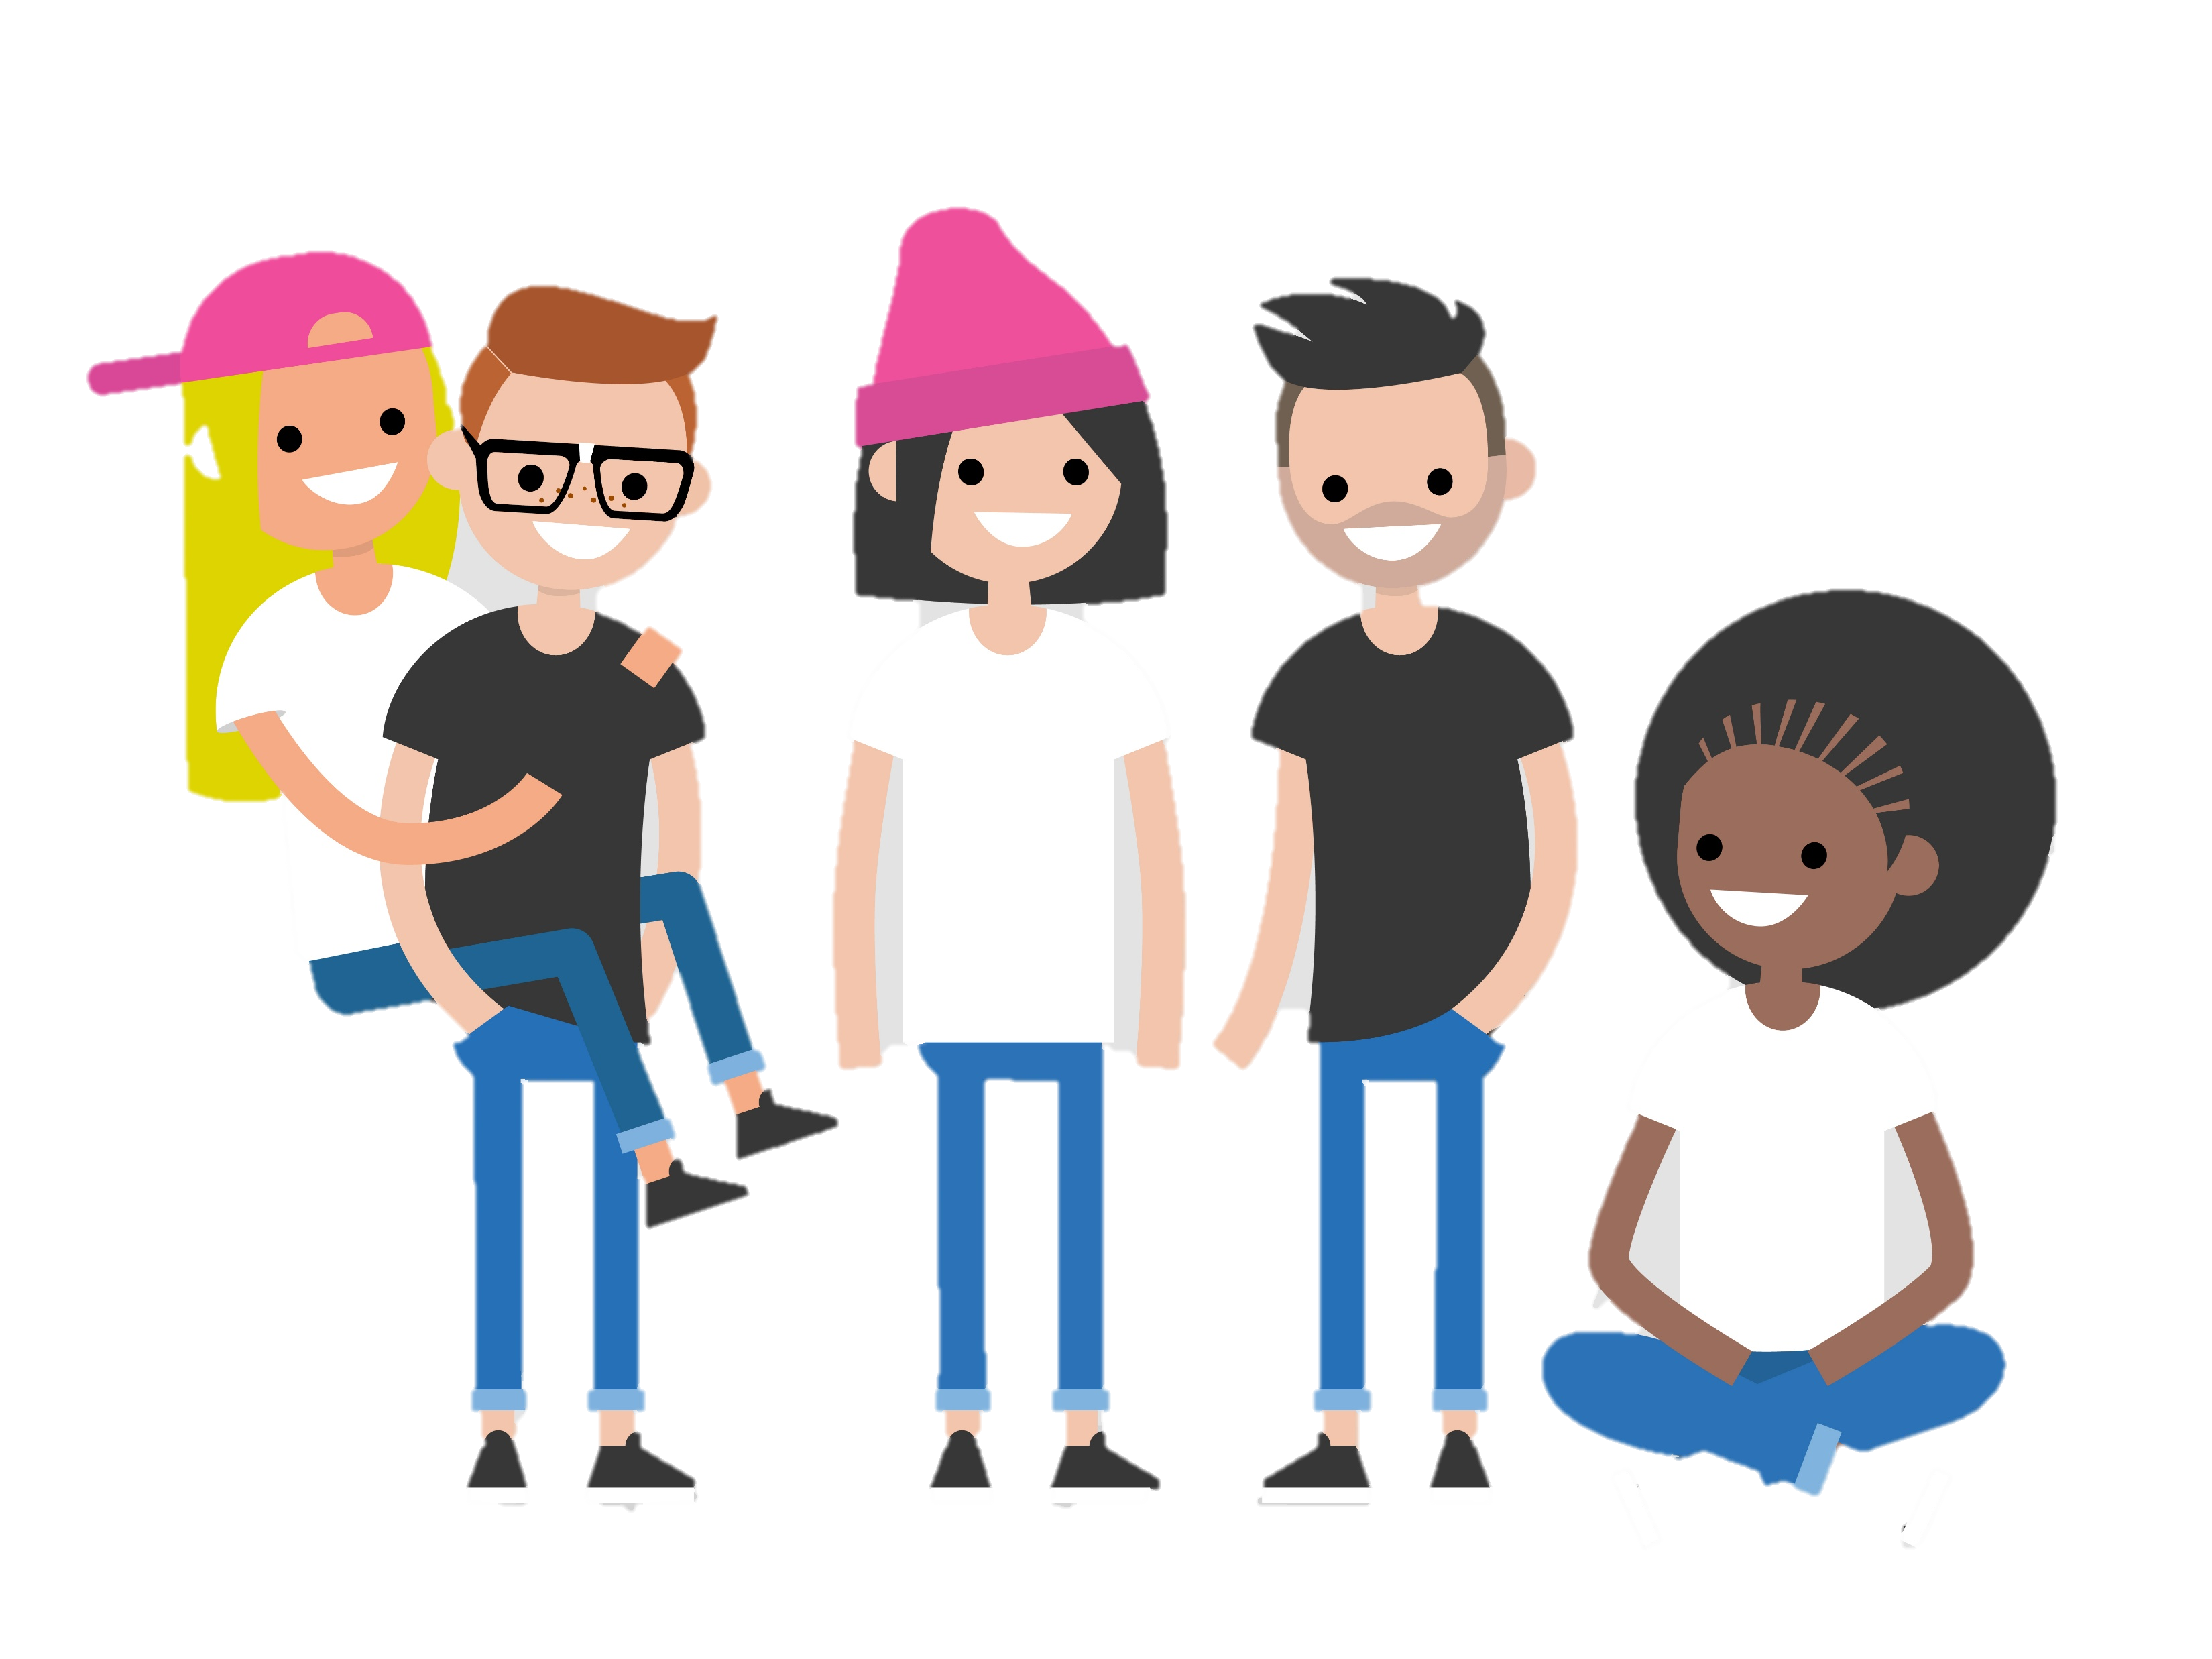
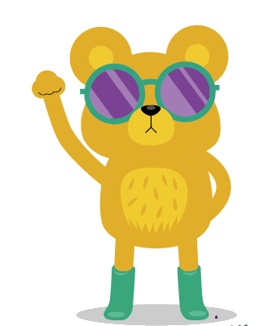


THE HEALTH RIGHTS POWER PACK
BECOME A HEALTH RIGHTS DEFENDER
Empowering individuals to protect the right of every child to the best possible health
With thanks to:

Slide 2
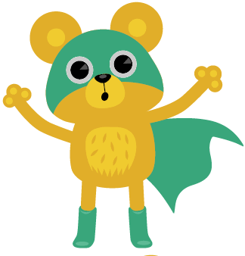
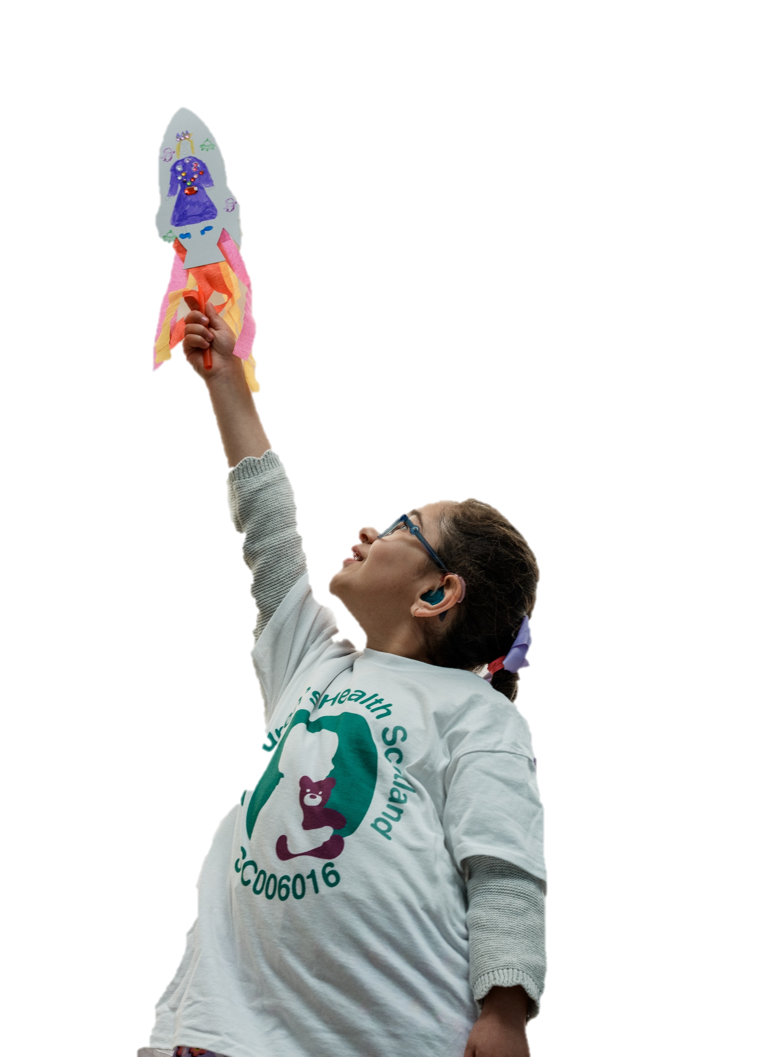
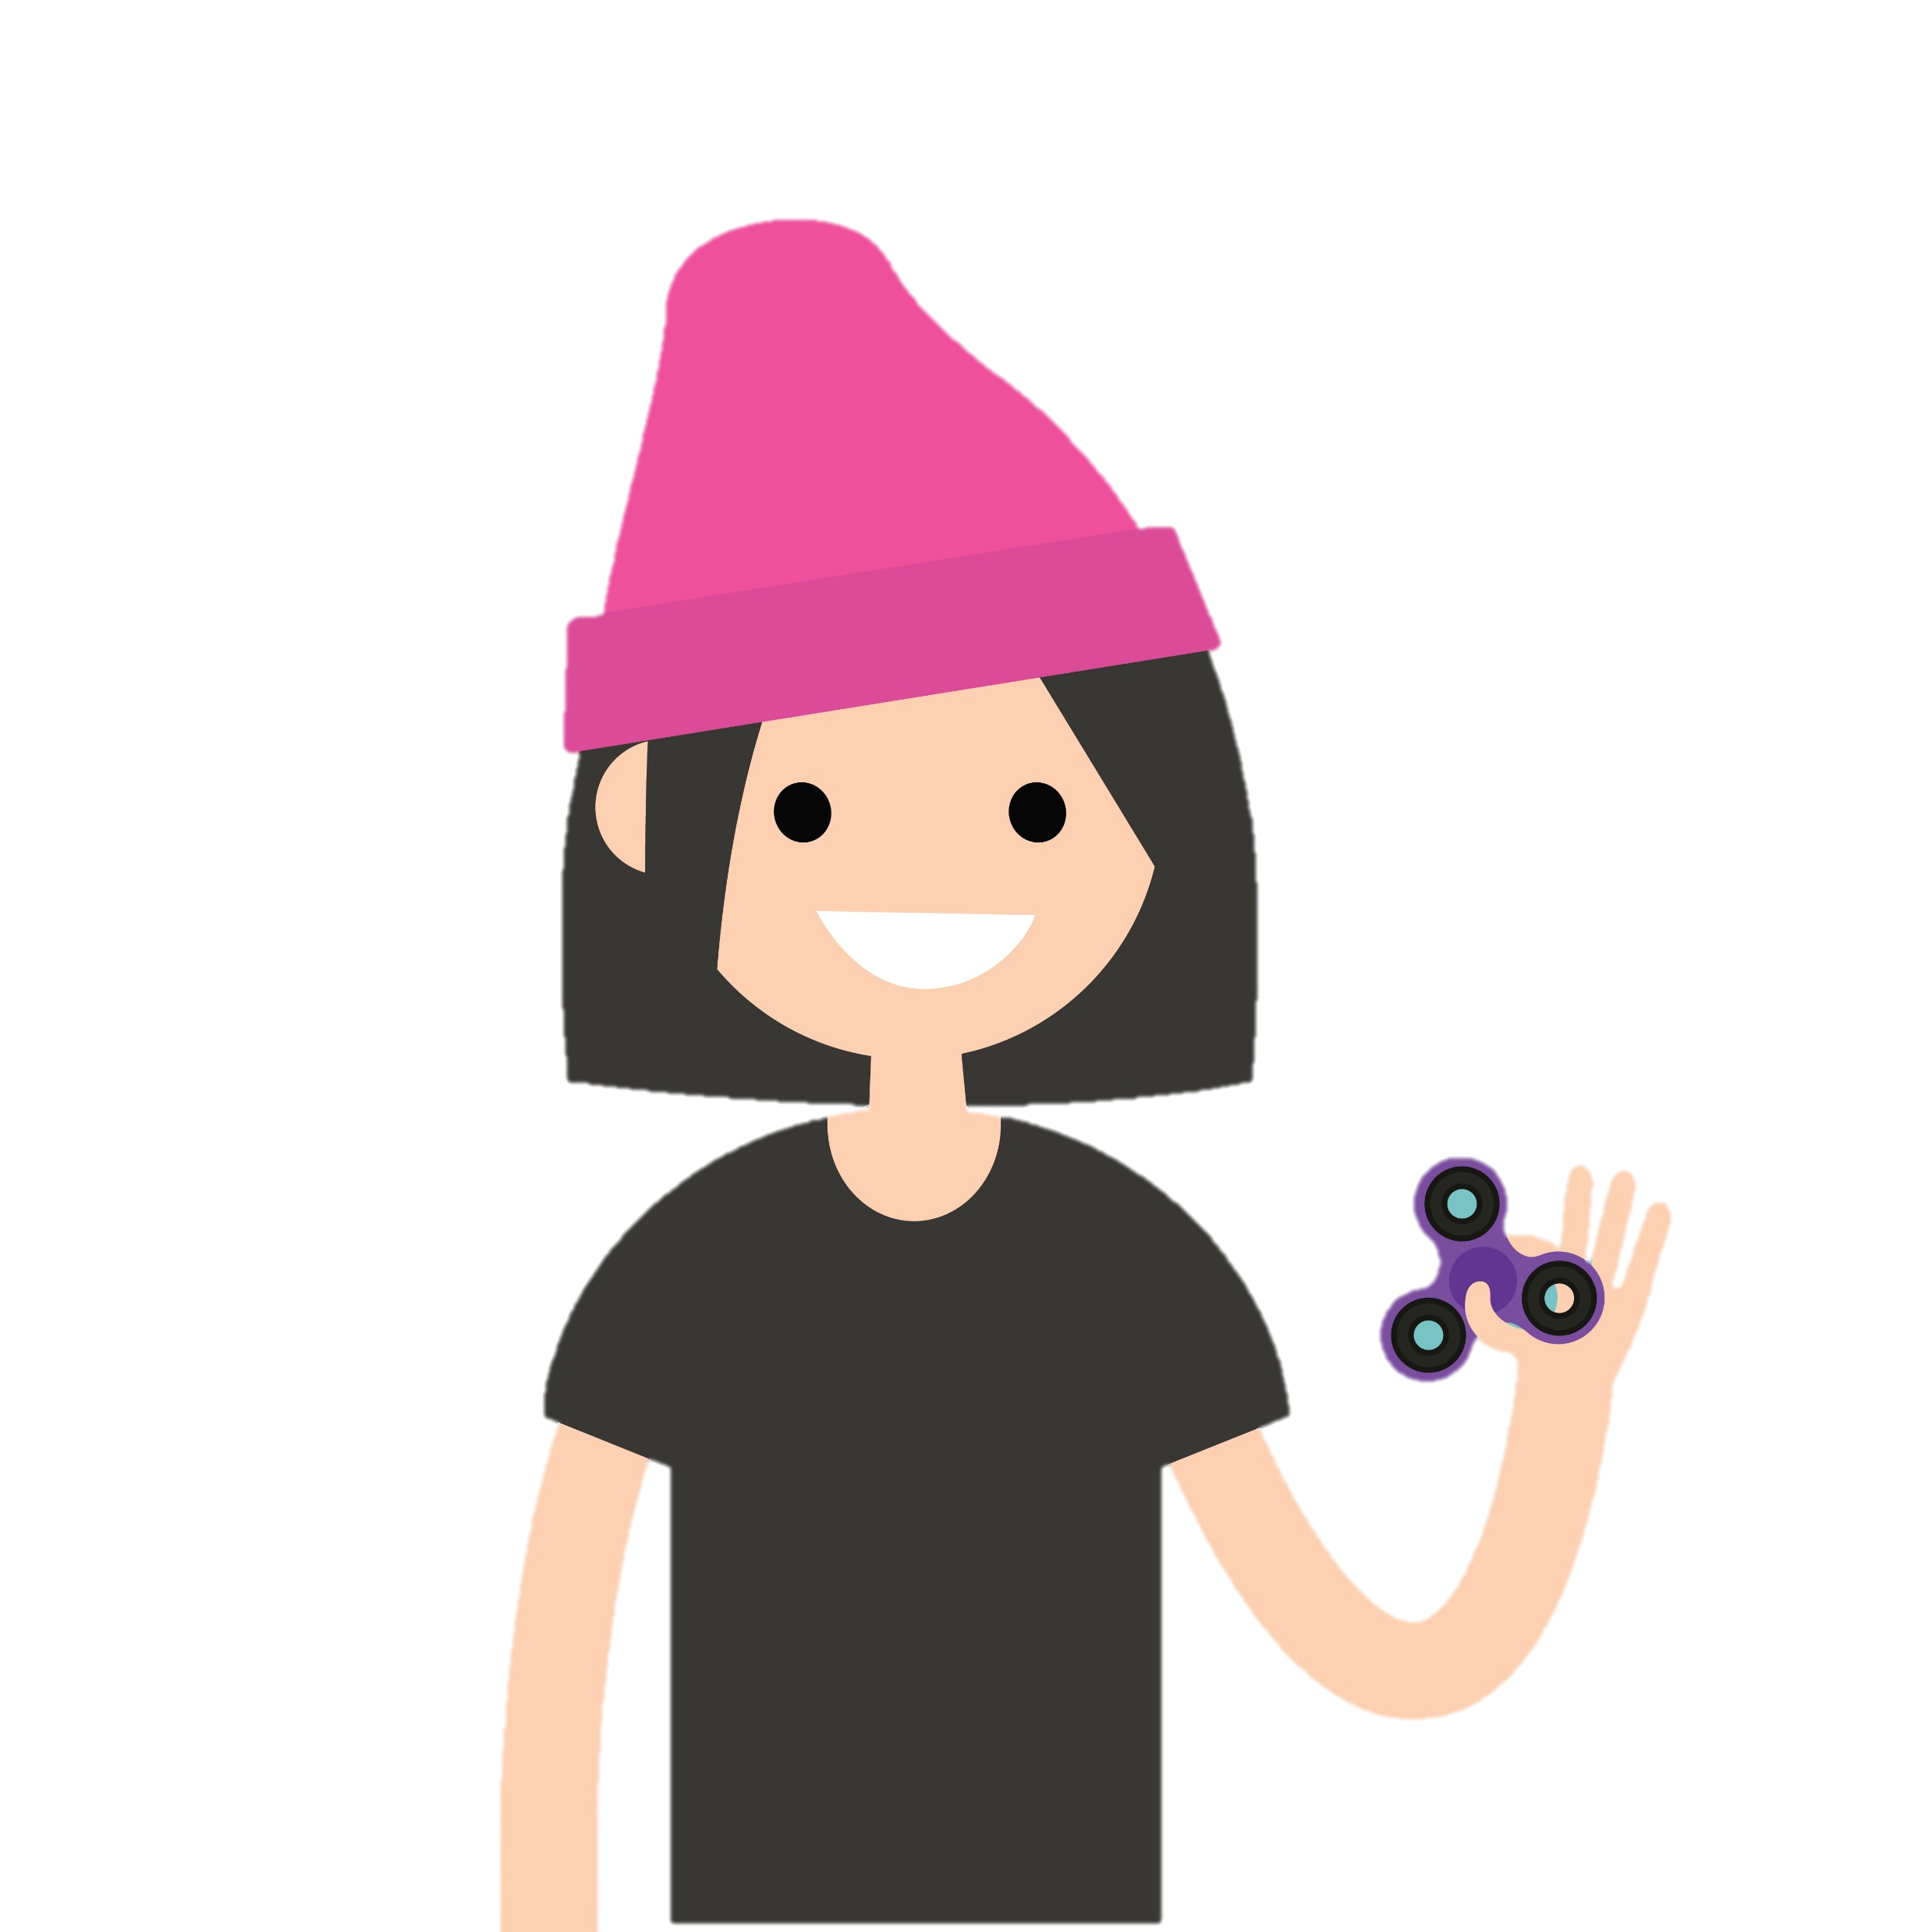
UNDERSTANDING YOUR HEALTH RIGHTS

Slide 3
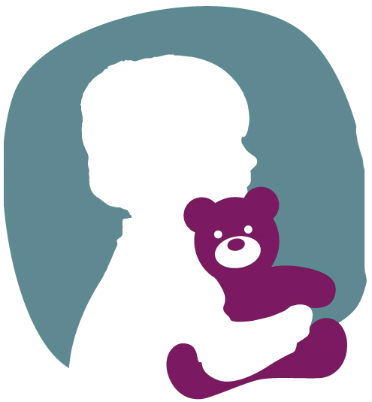
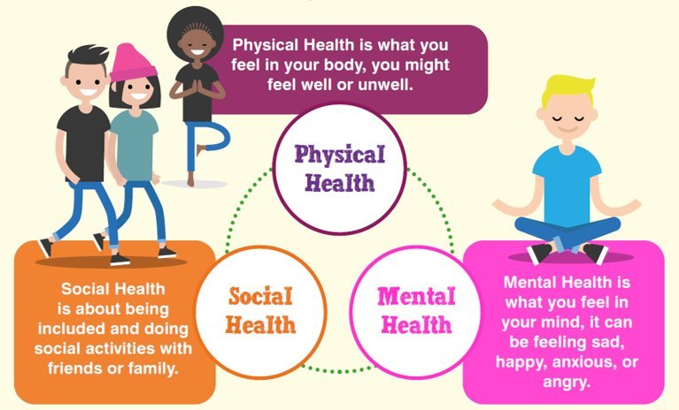
Notes:
World Health Organisation defines health as “a state of complete physical, mental ,and social wellbeing and not merely the absence of disease or infirmity“.​​
Children and Young People have a right to the best possible health under Article24 of the UNCRC.​​
The EACH Charter protects Children and Young People’s rights in Healthcare

Slide 4

What is a right?
Rights help protect people and make sure everyone is treated fairly. It isn’t something you earn. Everyone has rights and they can’t be taken away from you.
It’s like a coat of arms. It sets out the promises adults have made to look after your health

Slide 5
The United Nations Convention On The Rights Of The Child (UNCRC)
It’s made up of 54 Articles, also known as rights. These Articles state what every child is entitled to.
It belongs to all children – no matter who they are, where they live or who looks after them.

Slide 6
The United Nations Convention On The Rights Of The Child (UNCRC)
‘Convention’ just means a group of adults agreed these rights. It is an agreement that says what rights all children have and how adults should look after and respect those rights.
The UNCRC is like a rulebook that explains children’s rights, like the right to be safe, to learn, to get help when you’re ill, and to have your views listened to.

Slide 7
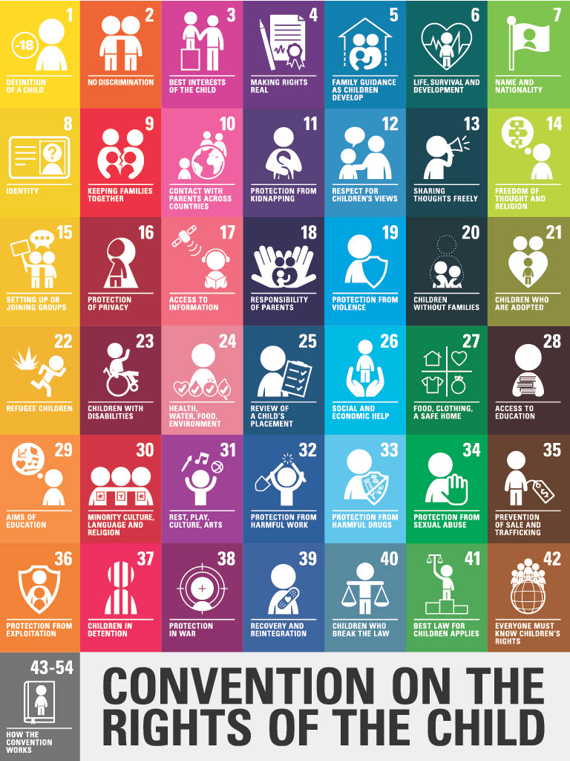
It’s looks like this. You might have seen this poster in your school.
Notes:
Link to the full UNCRC: https://www.unicef.org.uk/what-we-do/un-convention-child-rights/

Slide 8
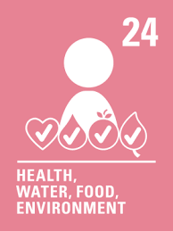
ARTICLE 24
This article states that children have the right to the best possible health and access to healthcare, including services for the treatment of illness and the promotion of health.

Slide 9
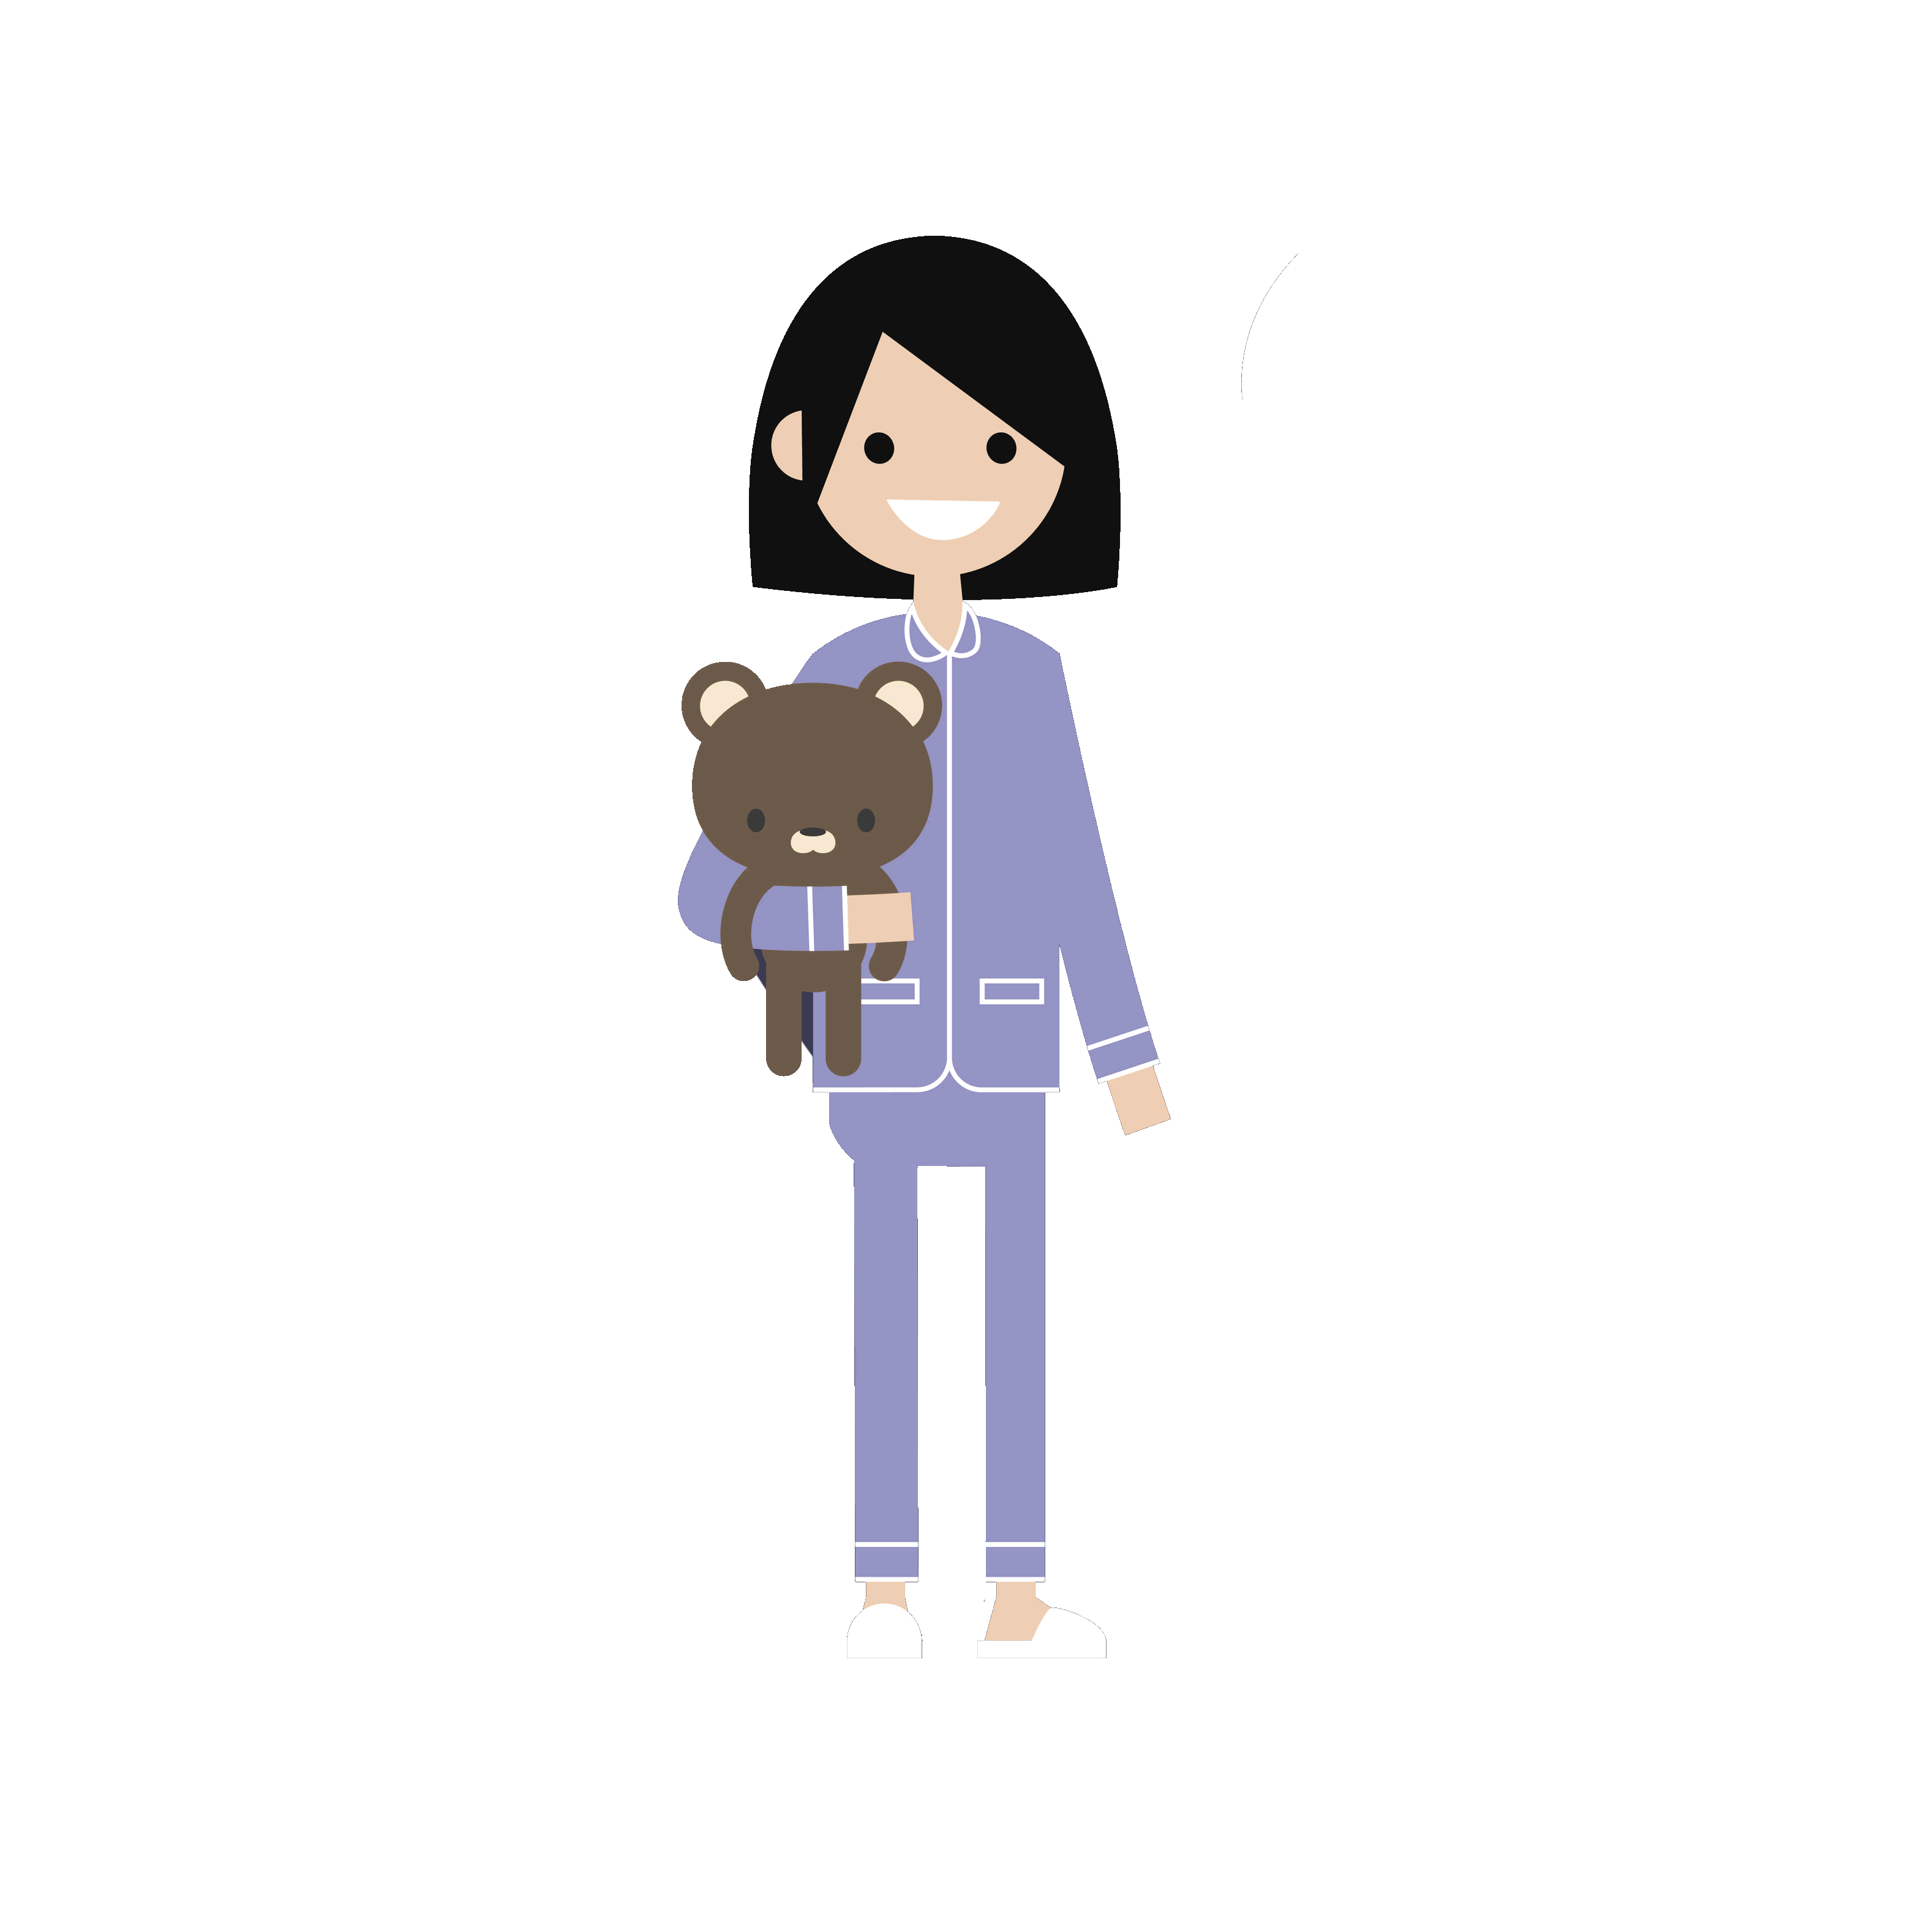
The European Association for Children in Hospital and Healthcare Charter (EACH)
It’s an agreement that lots of European countries have signed up to. They learned and listened to children about what they’d like when it comes to looking after their health. We’ve had it in Scotland since 1988.
The EACH Charter is a promise that children will be cared for kindly and fairly when they need healthcare
Notes:
(EACH – European Association for Children in Hospital and Healthcare – is an international umbrella organisation open to European non-governmental, non-profit associations involved in the welfare of children in hospital and other healthcare services. In 1988 EACH members created a Charter stipulating in 10 points the rights of sick children and their families before, during and after a stay in hospital and in other healthcare services.
Since its adoption in 1988 the EACH Charter has been used by EACH members as guidance for protecting the rights and well-being of sick children and eventually has served as a basis for healthcare legislation and professional guidelines in many European countries.) this is the EACH link https://each-for-sick-children.org/

Slide 10
The European Association for Children in Hospital and Healthcare Charter (EACH)
It’s made up of 10 Articles. It focuses specifically on rights you need when it comes to your health and wellbeing.
It belongs to all children – no matter who they are, where they live or who looks after them.

Slide 11
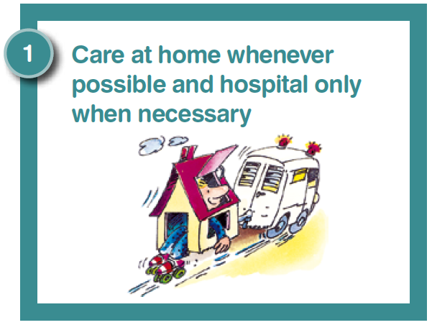
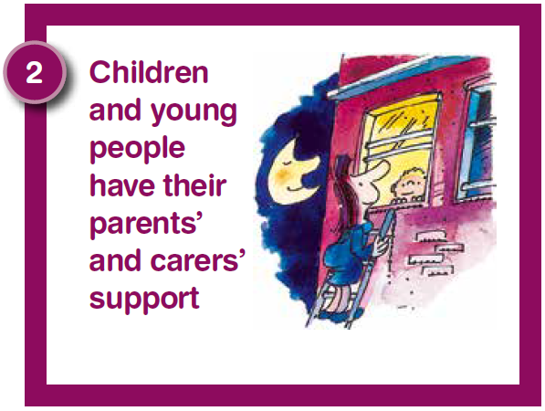
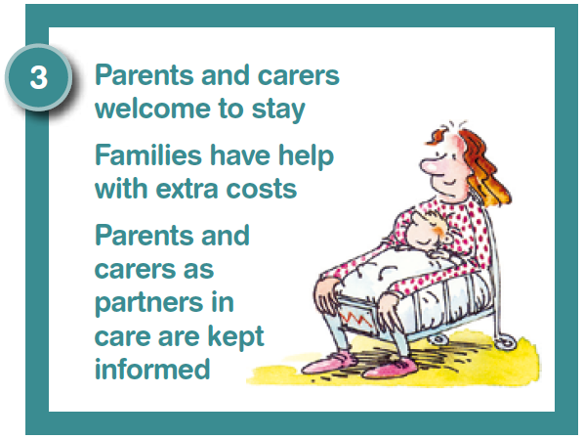
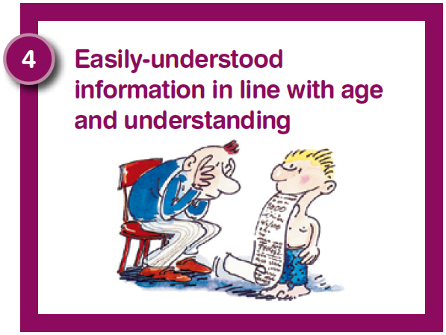
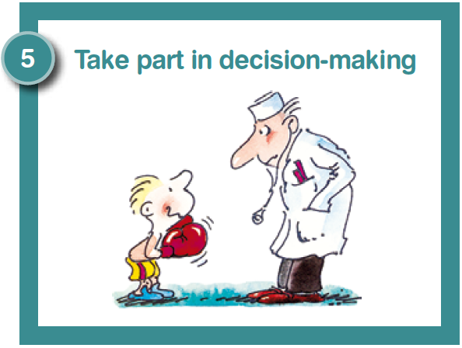
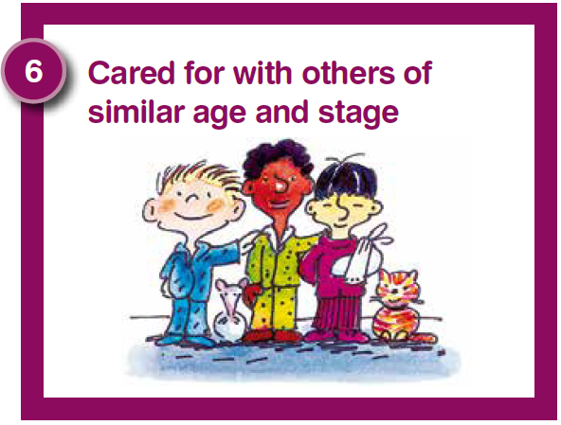
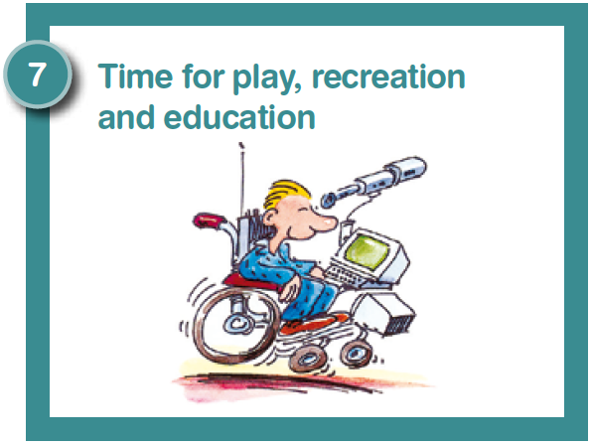
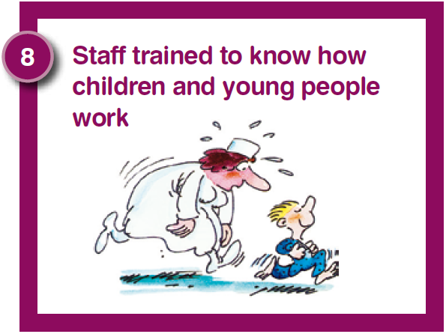
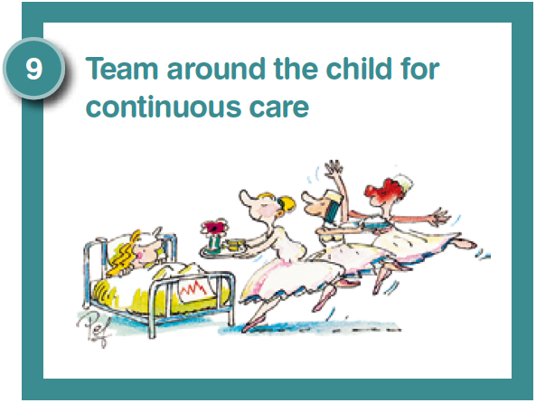
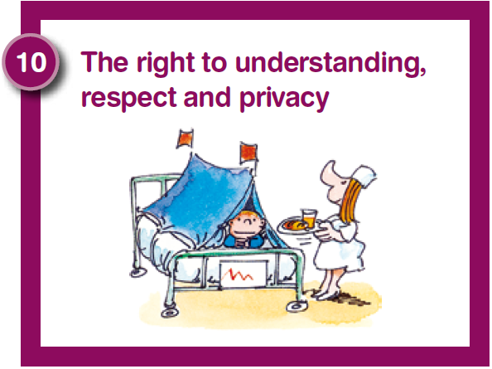


This version was made by Children’s Health Scotland
Notes:
Here is the link to the EACH Charter on our website: https://www.childrenshealthscotland.org/childrens-healthcare-rights/the-each-charter/

Slide 12
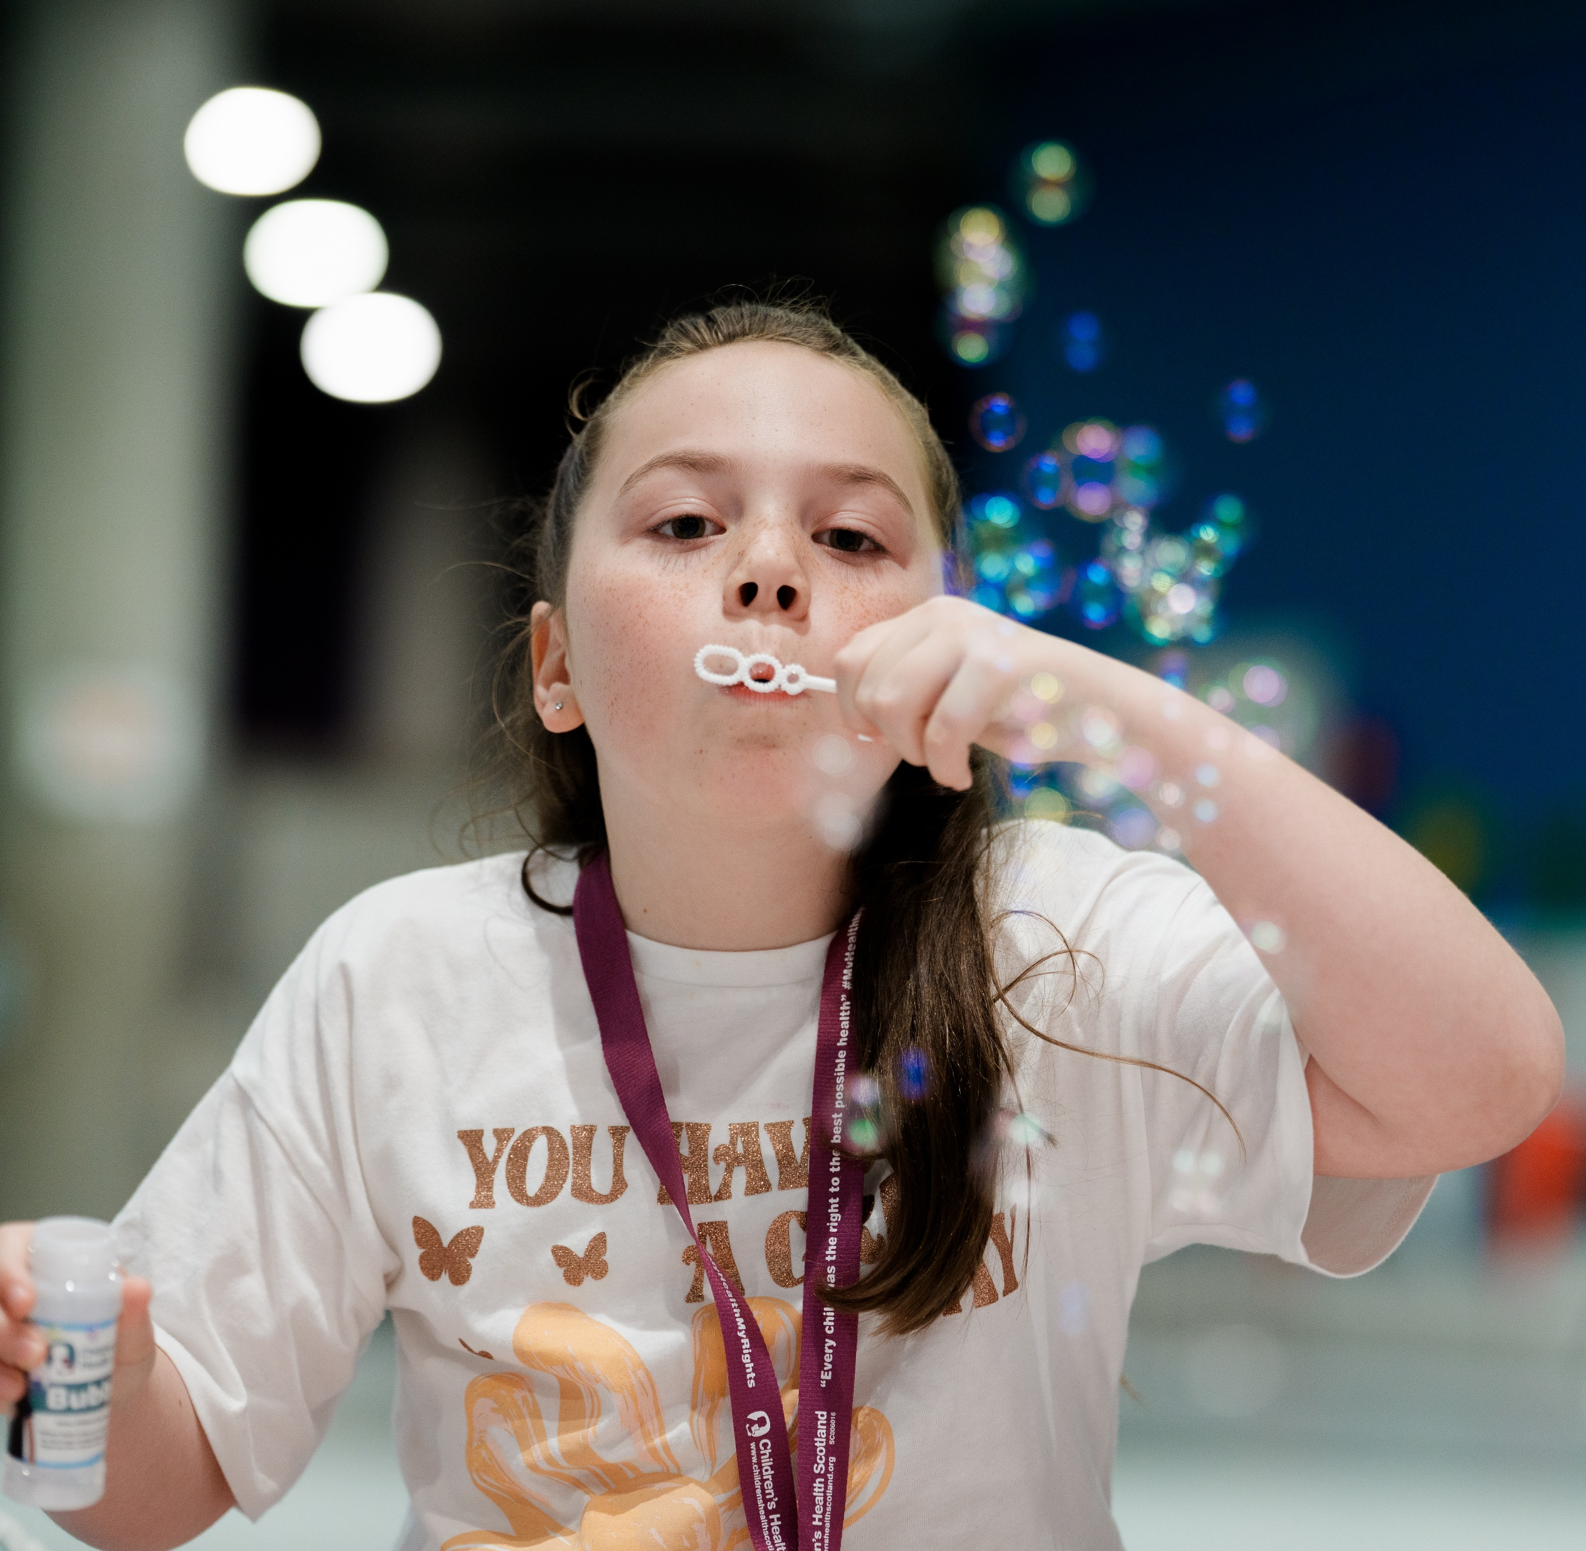
My Health, My Rights: A Charter for Change
The My Health, My Rights Charter was created by our amazing Health Rights Defenders — children and young people who speak up for the rights of all children in Scotland. The Charter reminds everyone (adults) that children must be listened to and get the care and support they need. Our Health Rights Defenders help remind adults to put children first and make sure your rights are respected.

Slide 13
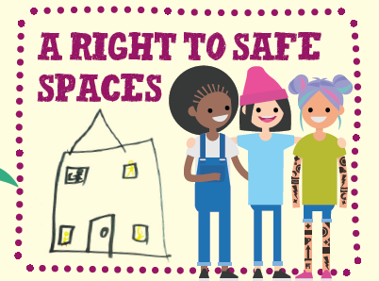
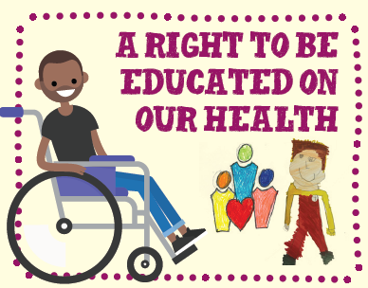
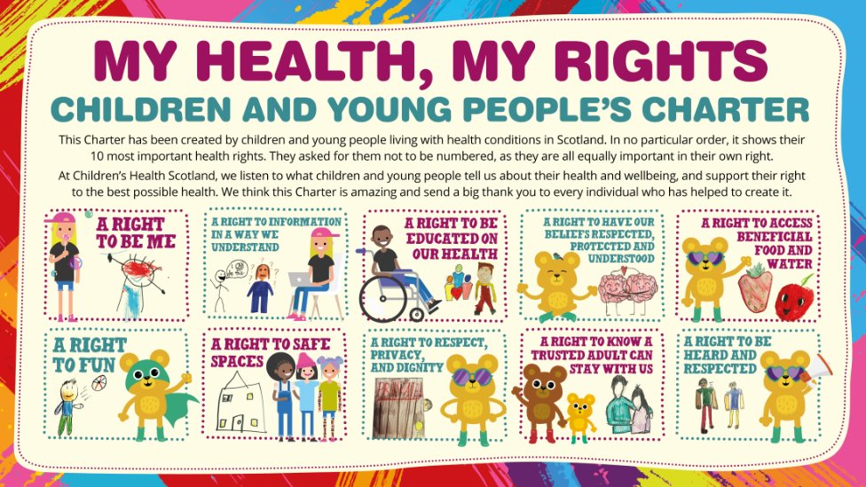
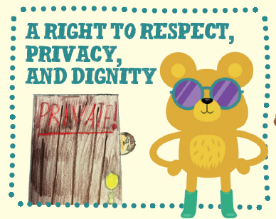
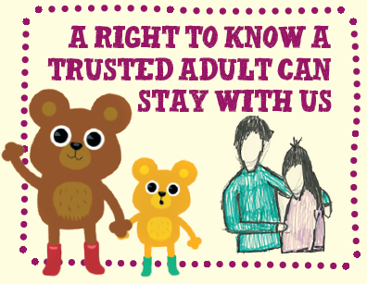
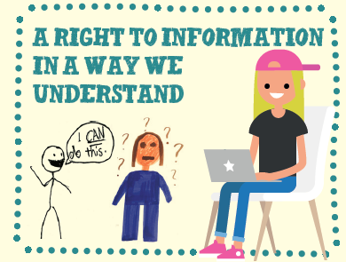

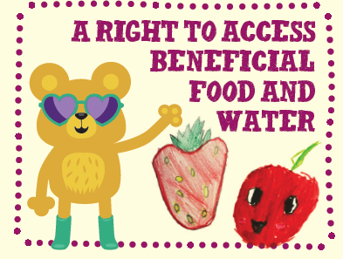
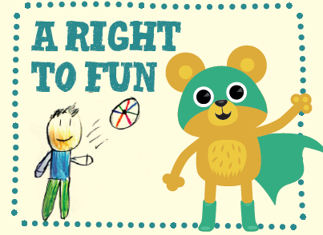
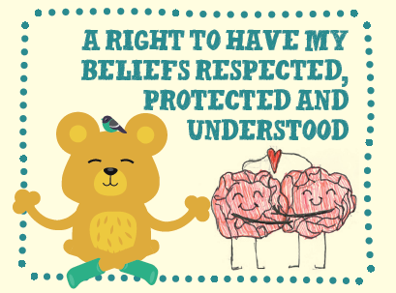
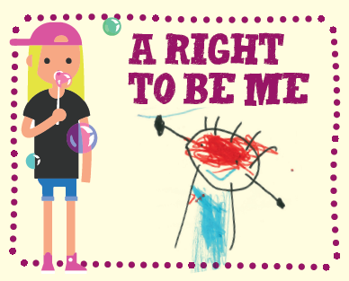
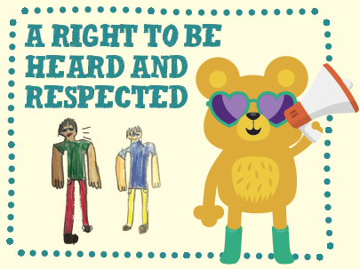

OUR CHARTER
This Charter has been created by children and young people living with health conditions in Scotland. In no particular order, it shows their 10 most important health rights. They asked for them not to be numbered, as they are all equally important in their own right.
At Children’s Health Scotland, we listen to what children and young people tell us about their health and wellbeing, and support their right to the best possible health. We think this Charter is amazing and send a big thank you to every individual who has helped to create it.
Notes:
This Charter has been created by children and young people living with health conditions in Scotland. In no particular order, it shows their 10 most important health rights. They asked for them not to be numbered, as they are all equally important in their own right.
At Children’s Health Scotland, we listen to what children and young people tell us about their health and wellbeing, and support their right to the best possible health. We think this Charter is amazing and send a big thank you to every individual who has helped to create it.

Slide 14
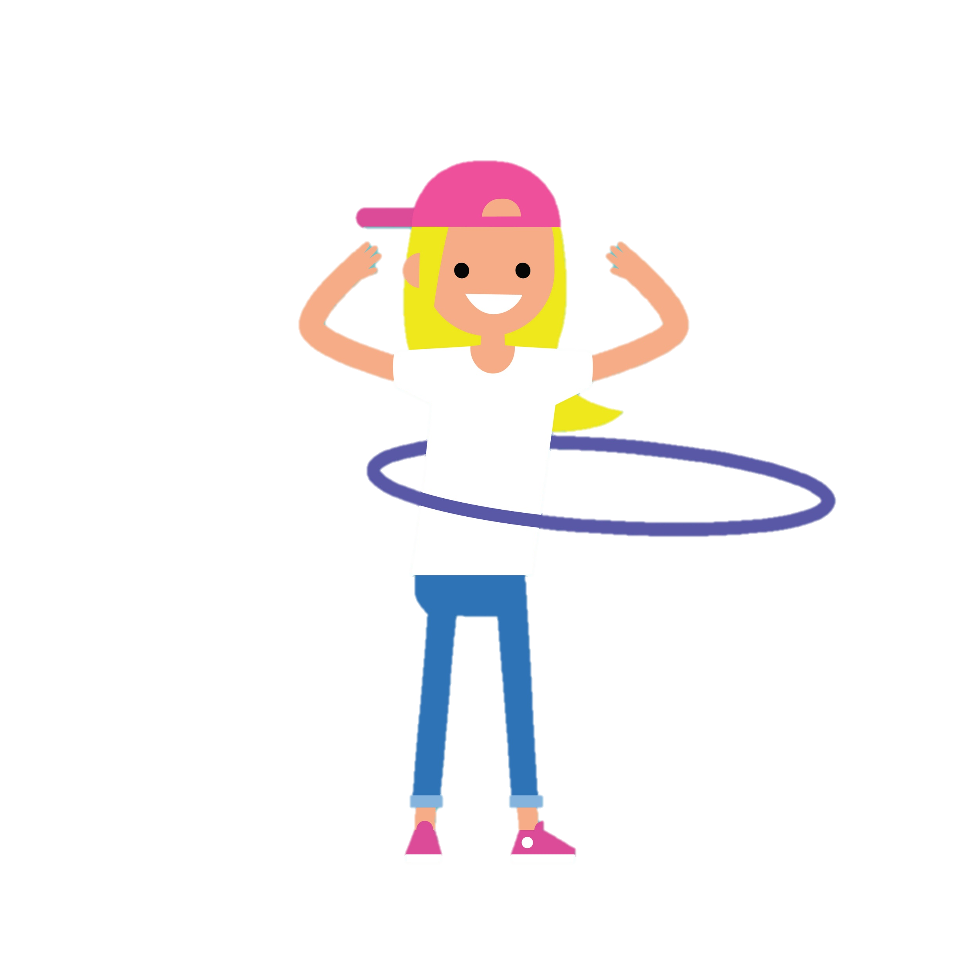
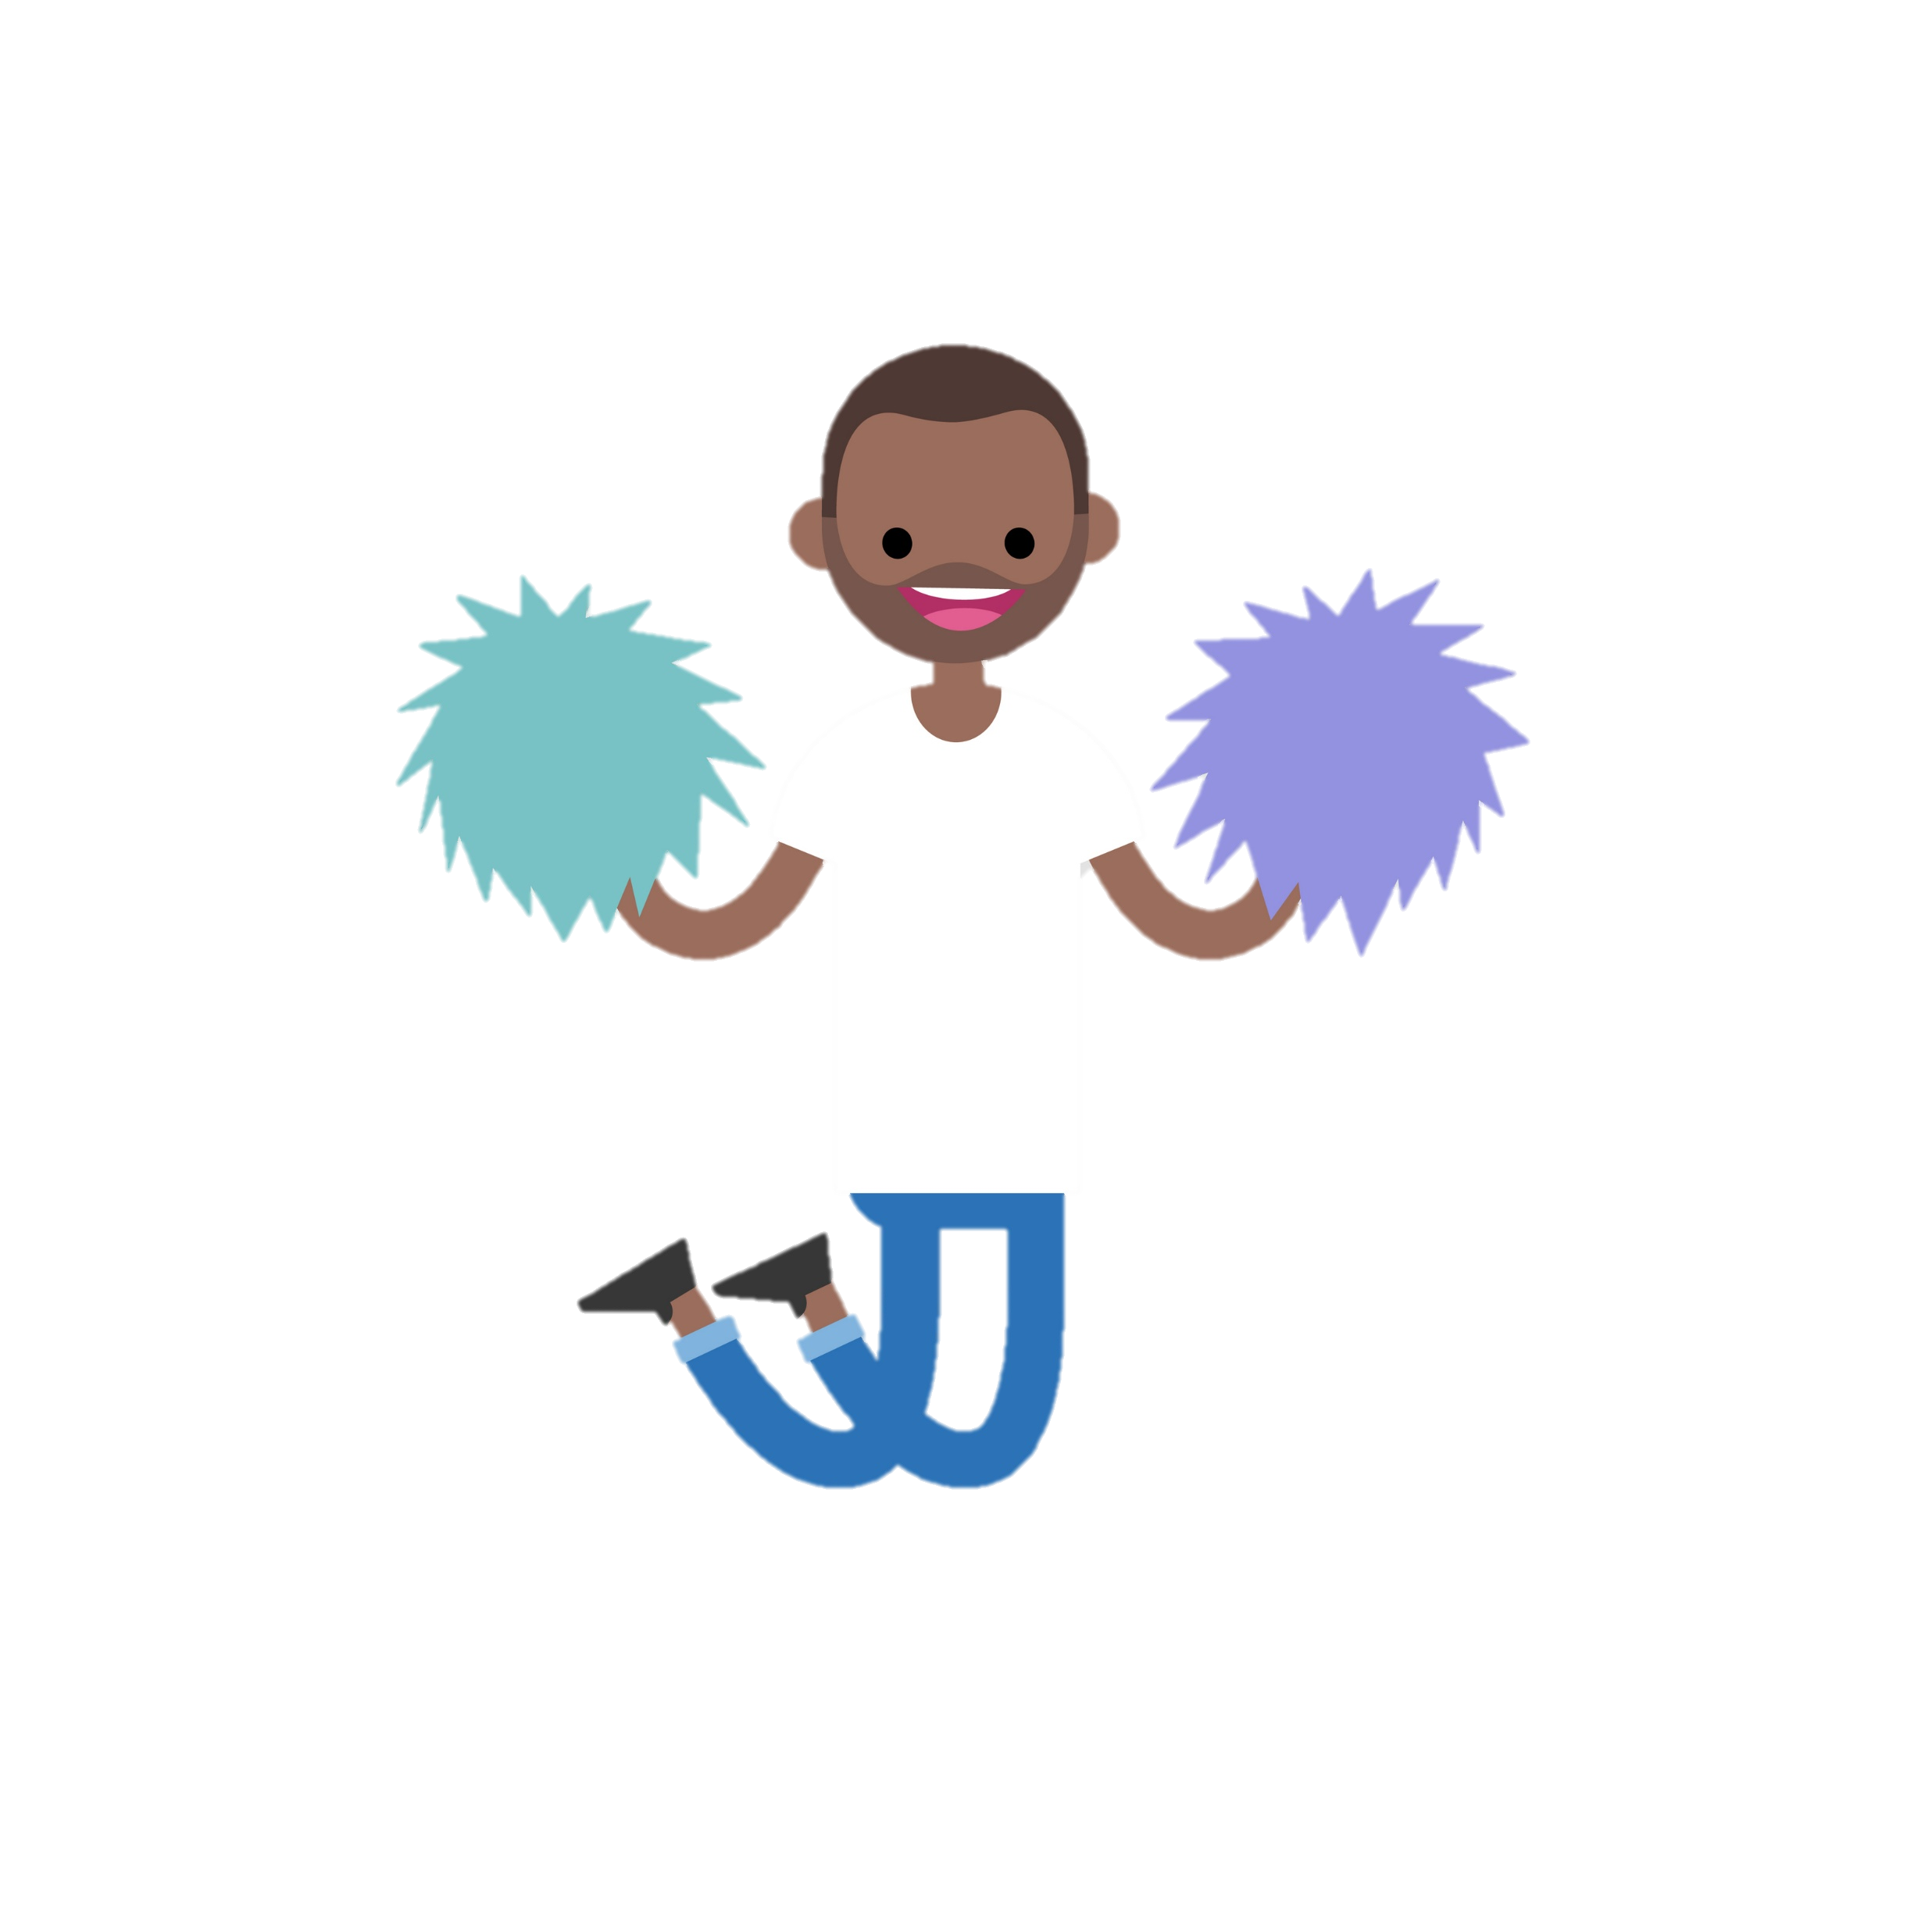
Interactive Activities

Slide 15

Create your own Health Rights Defender
Creative Character Design
Pupils create Health Rights Defender characters, choosing names, power poses, and super skills to express confidence and resilience. What does a Health Rights Defender do to defend children’s health rights?
Power Pack Selection
Children select up to three things that support you ‘ like a super power.’ For example: kind staff or quiet spaces to include in their Defender’s Power Pack.
Health Rights Defenders coat of arms
What are three things you’d want to defend for children’s health rights?
Each Defender has Empowering Participation
The activity encourages pride and ownership, turning feedback into an empowering experience for children.
Send your completed Defender to CYPHRS@childrenshealthscotland.org
Notes:
Build Your Health Rights Defender is a creative activity that invites pupils to design their own Health Rights Defender character, complete with a name, power pose, and super skills. This exercise helps children articulate what supports them in health settings and what personal strengths they bring to challenging situations. Pupils start by naming their defender and illustrating a power pose that symbolizes confidence and resilience. Next, they select up to three items for their Power Pack, such as kind staff, quiet spaces, clear information, play opportunities, or trusted adults. Finally, children can make their very own coat of arms, just like our badges, with three things they want to defend. This activity not only sparks creativity but also provides valuable insights into children’s priorities and concerns. Teachers can display the completed defenders in a gallery or photograph them for submission, creating a sense of pride and ownership among pupils. By framing participation as a fun, imaginative challenge, Build Your Defender transforms feedback into an empowering experience that reinforces the message that every child can be a defender of health rights.

Slide 16
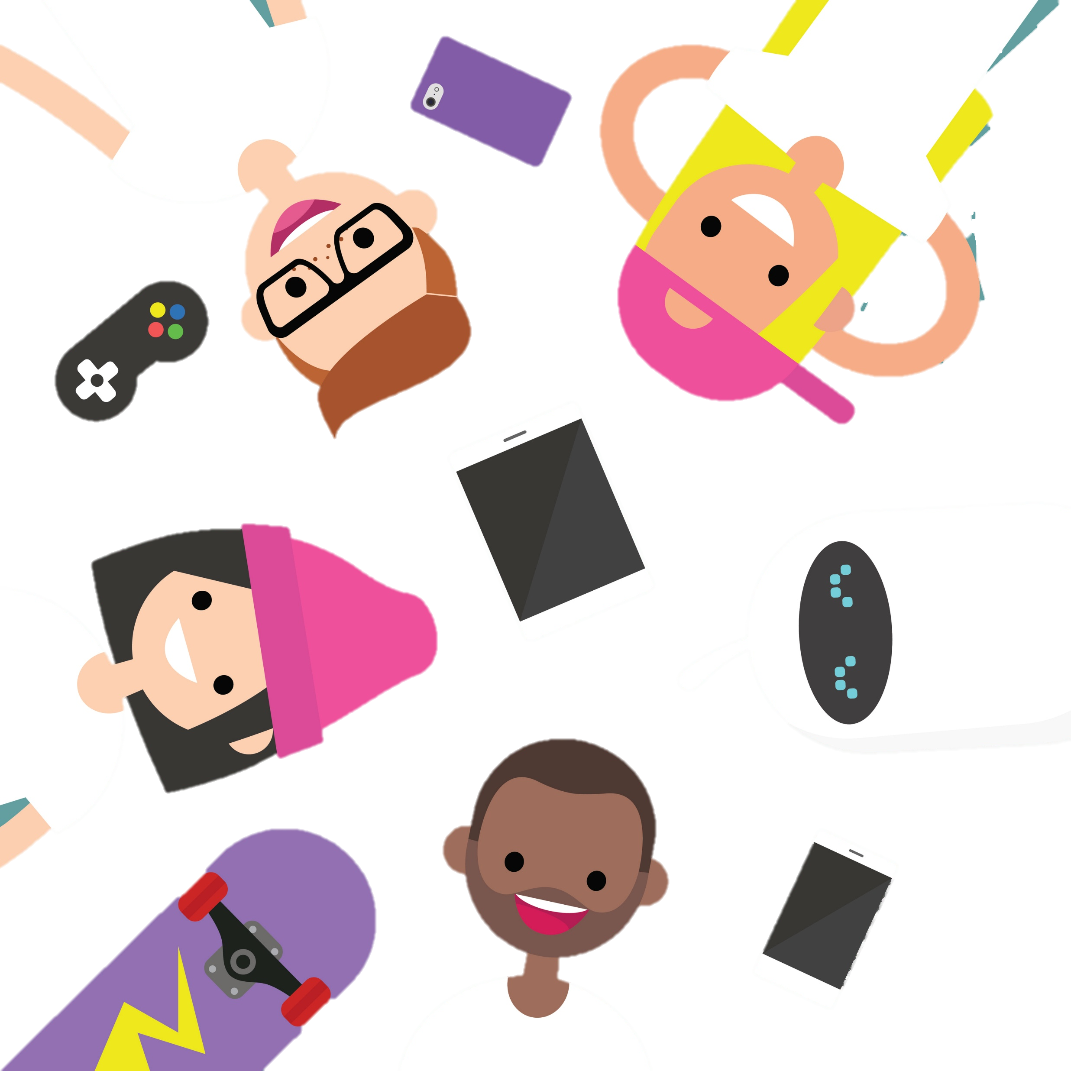
Rights Quest Game
Interactive Health Rights Learning
The game uses real life scenarios to help pupils understand and apply their health rights effectively.
Problem Solving and Advocacy
Pupils choose suitable Health Rights Defender Actions, encouraging problem-solving and learning to advocate for themselves.
Teamwork and Communication
The game promotes teamwork and communication skills, suitable for both primary and secondary education settings.
Educational Tool Adaptability
Simple and adaptable design allows teachers to facilitate debriefs and connect learning to health rights surveys.
Notes:
Rights Quest is an interactive game designed to help pupils apply health rights to real-life scenarios. Working in pairs or small groups, pupils receive cards with situations such as feeling worried before a scan, missing schoolwork during a hospital stay, or needing support at the dentist. For each scenario, they choose the best Defender Action, such as asking for play support, requesting clear explanations, or seeking a quiet space. This activity encourages problem-solving and reinforces the practical value of health rights in everyday experiences. By discussing their choices, pupils learn that rights are actionable and that they have the power to advocate for themselves. Rights Quest also promotes teamwork and communication skills, making it suitable for both primary and secondary settings. Teachers can facilitate a quick debrief to highlight common themes and connect them to Children’s Health Scotland’s National Health Rights Survey. The game’s simplicity and adaptability make it an excellent tool for engaging pupils while collecting meaningful insights into their understanding of rights and their expectations of health services. Teachers can fill in the children’s survey for a younger age group or can send us pupil's feedback

Slide 17

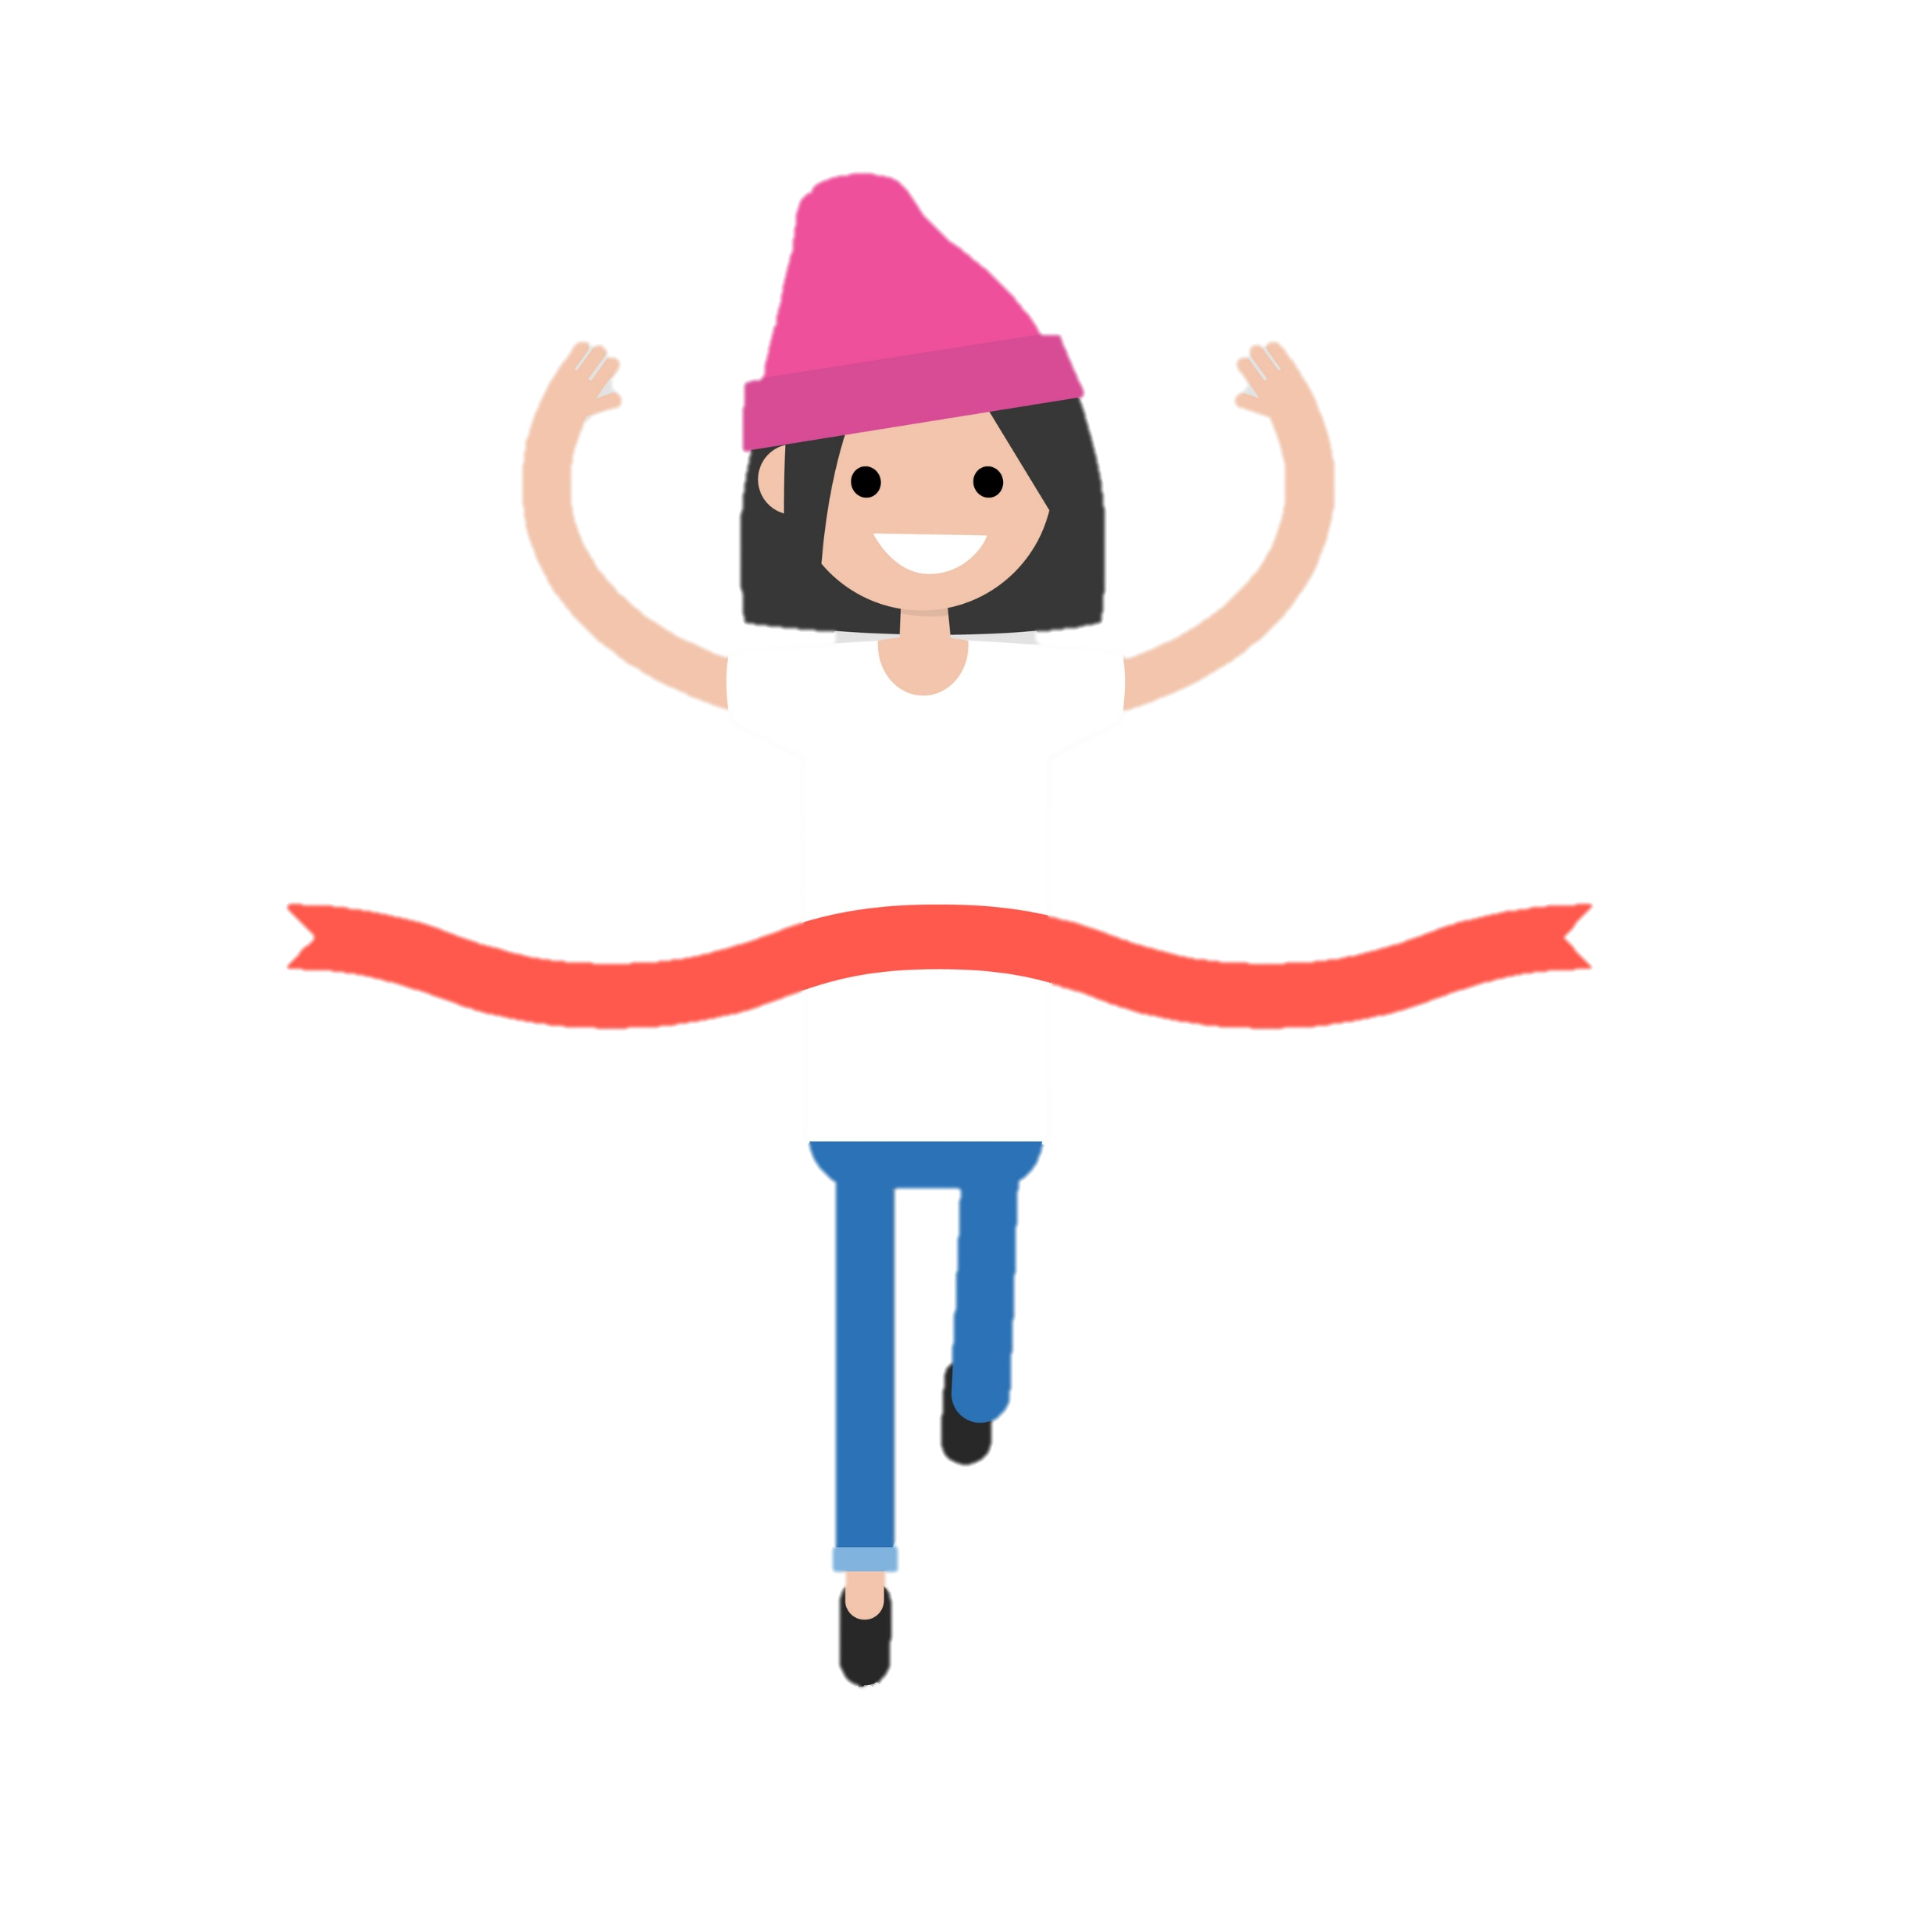
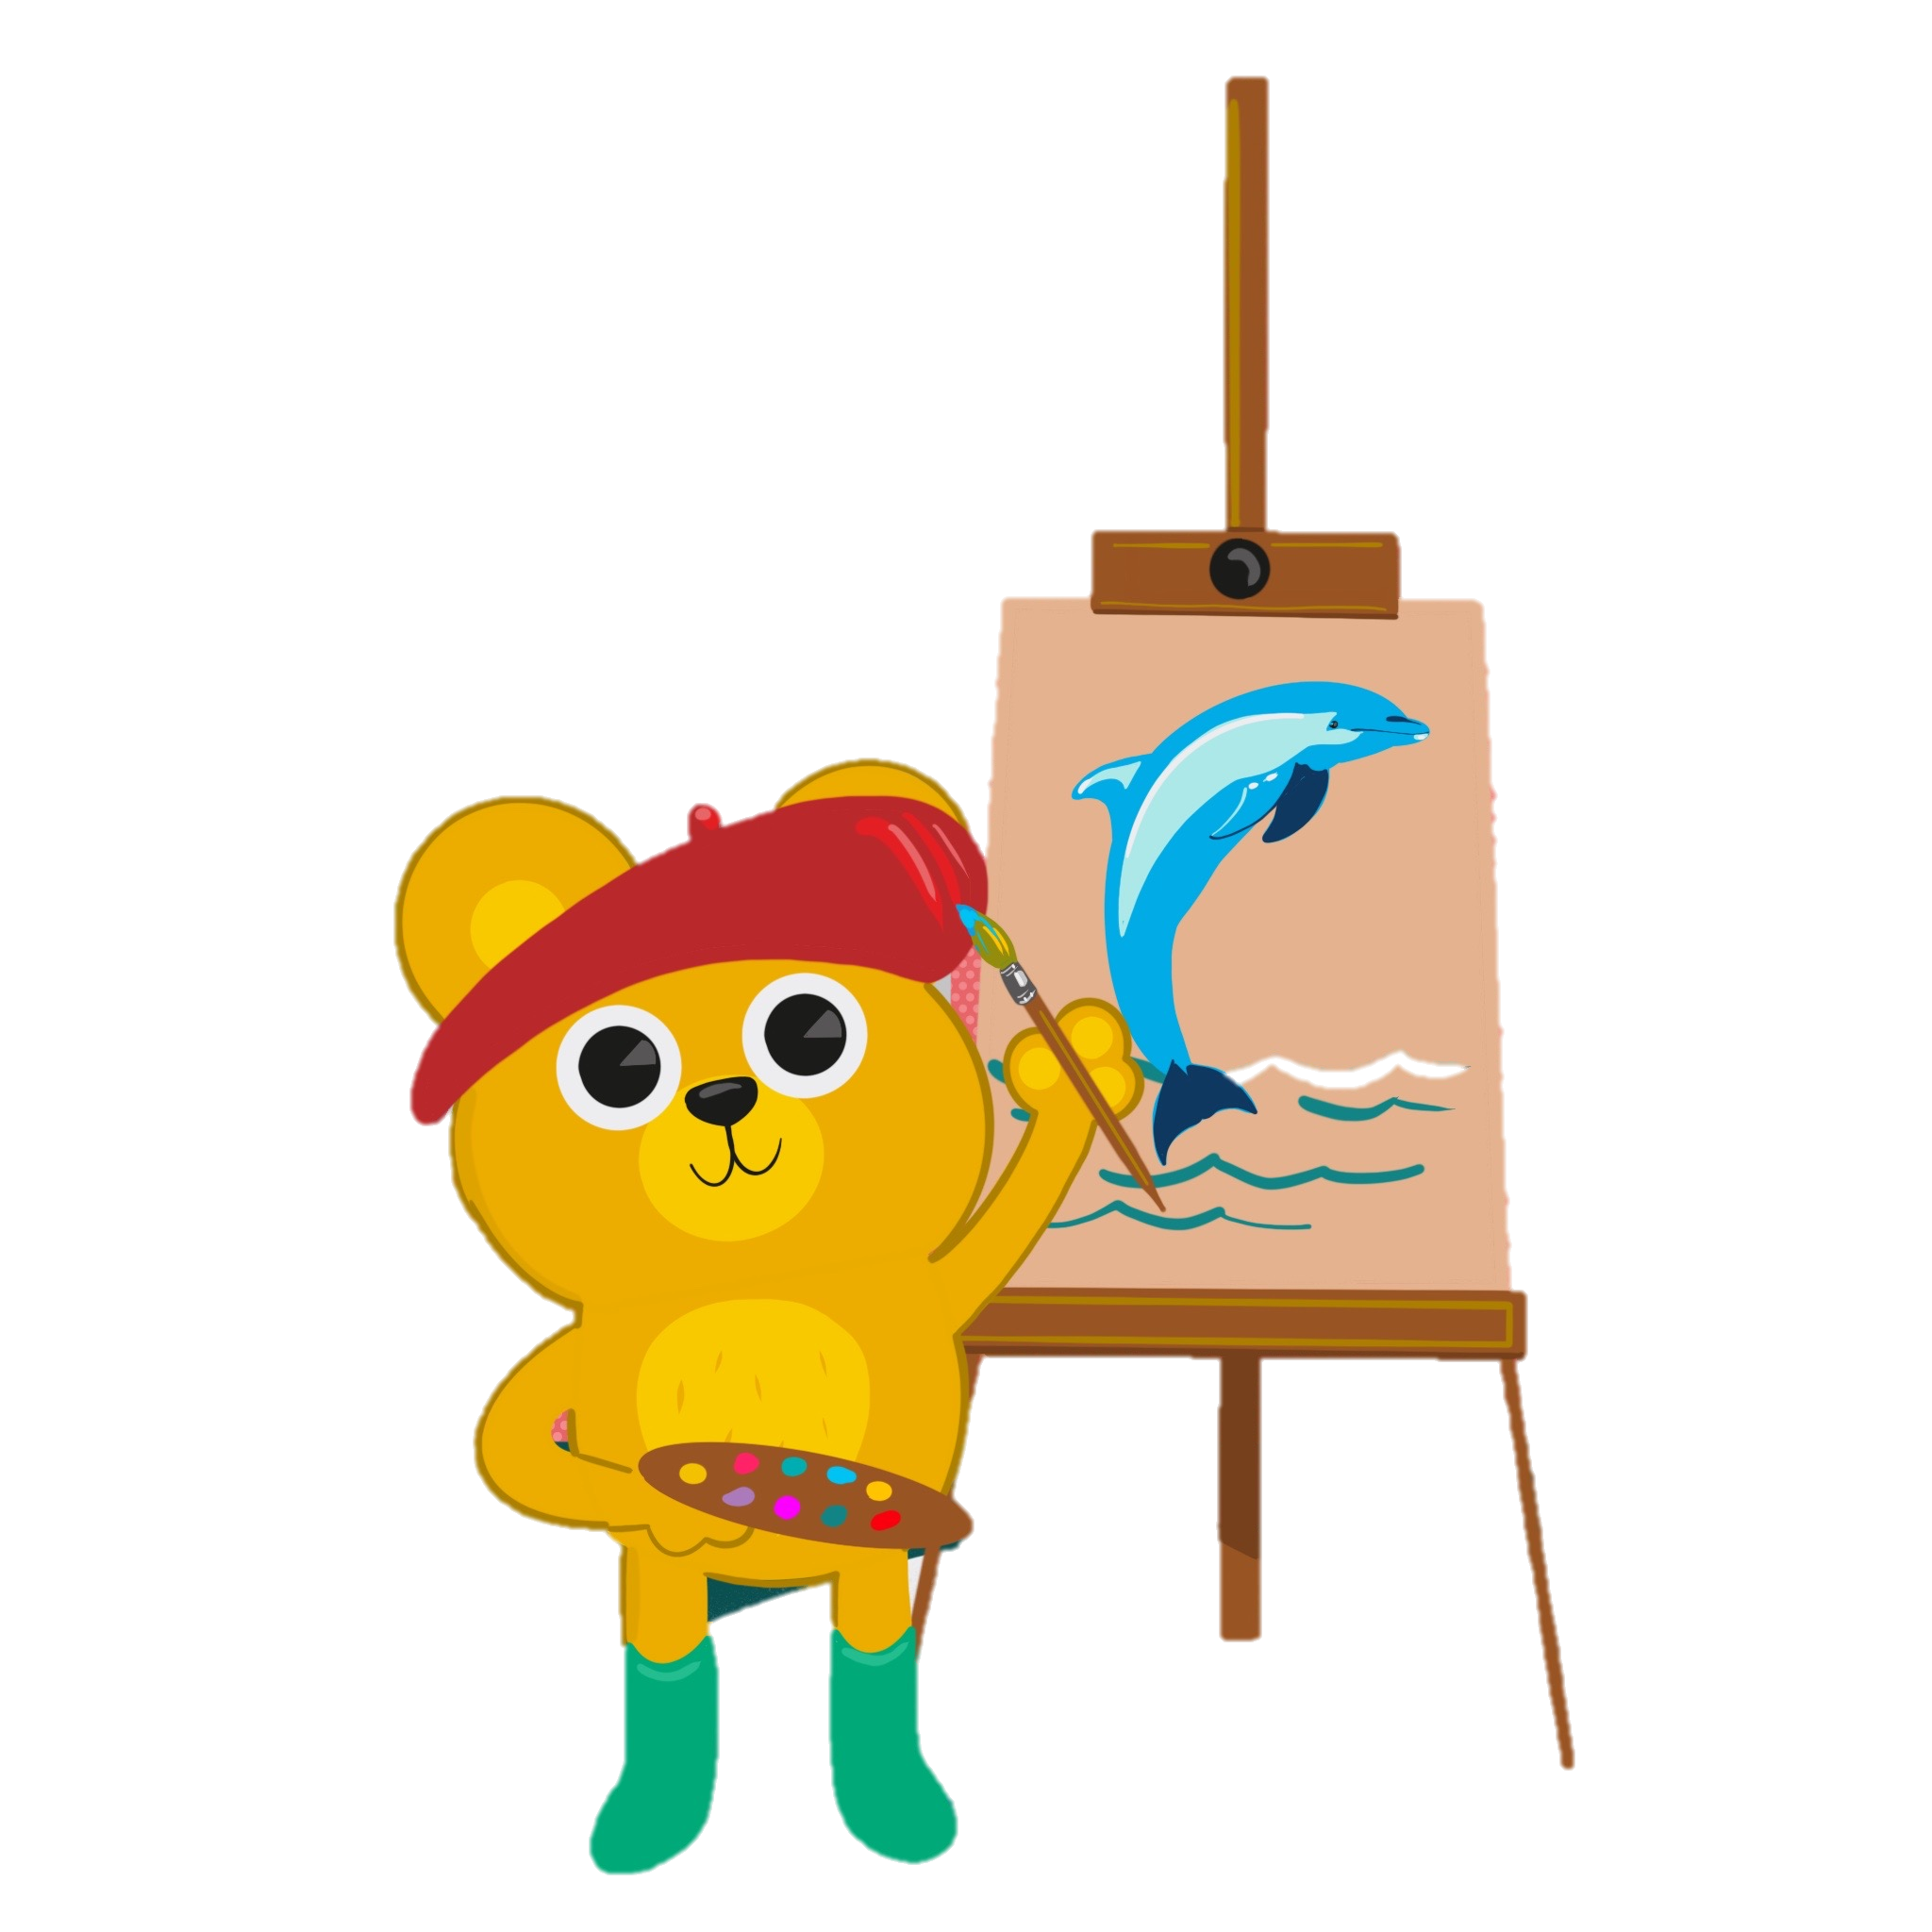
CREATIVE EXPRESSION AND FEEDBACK

Slide 18
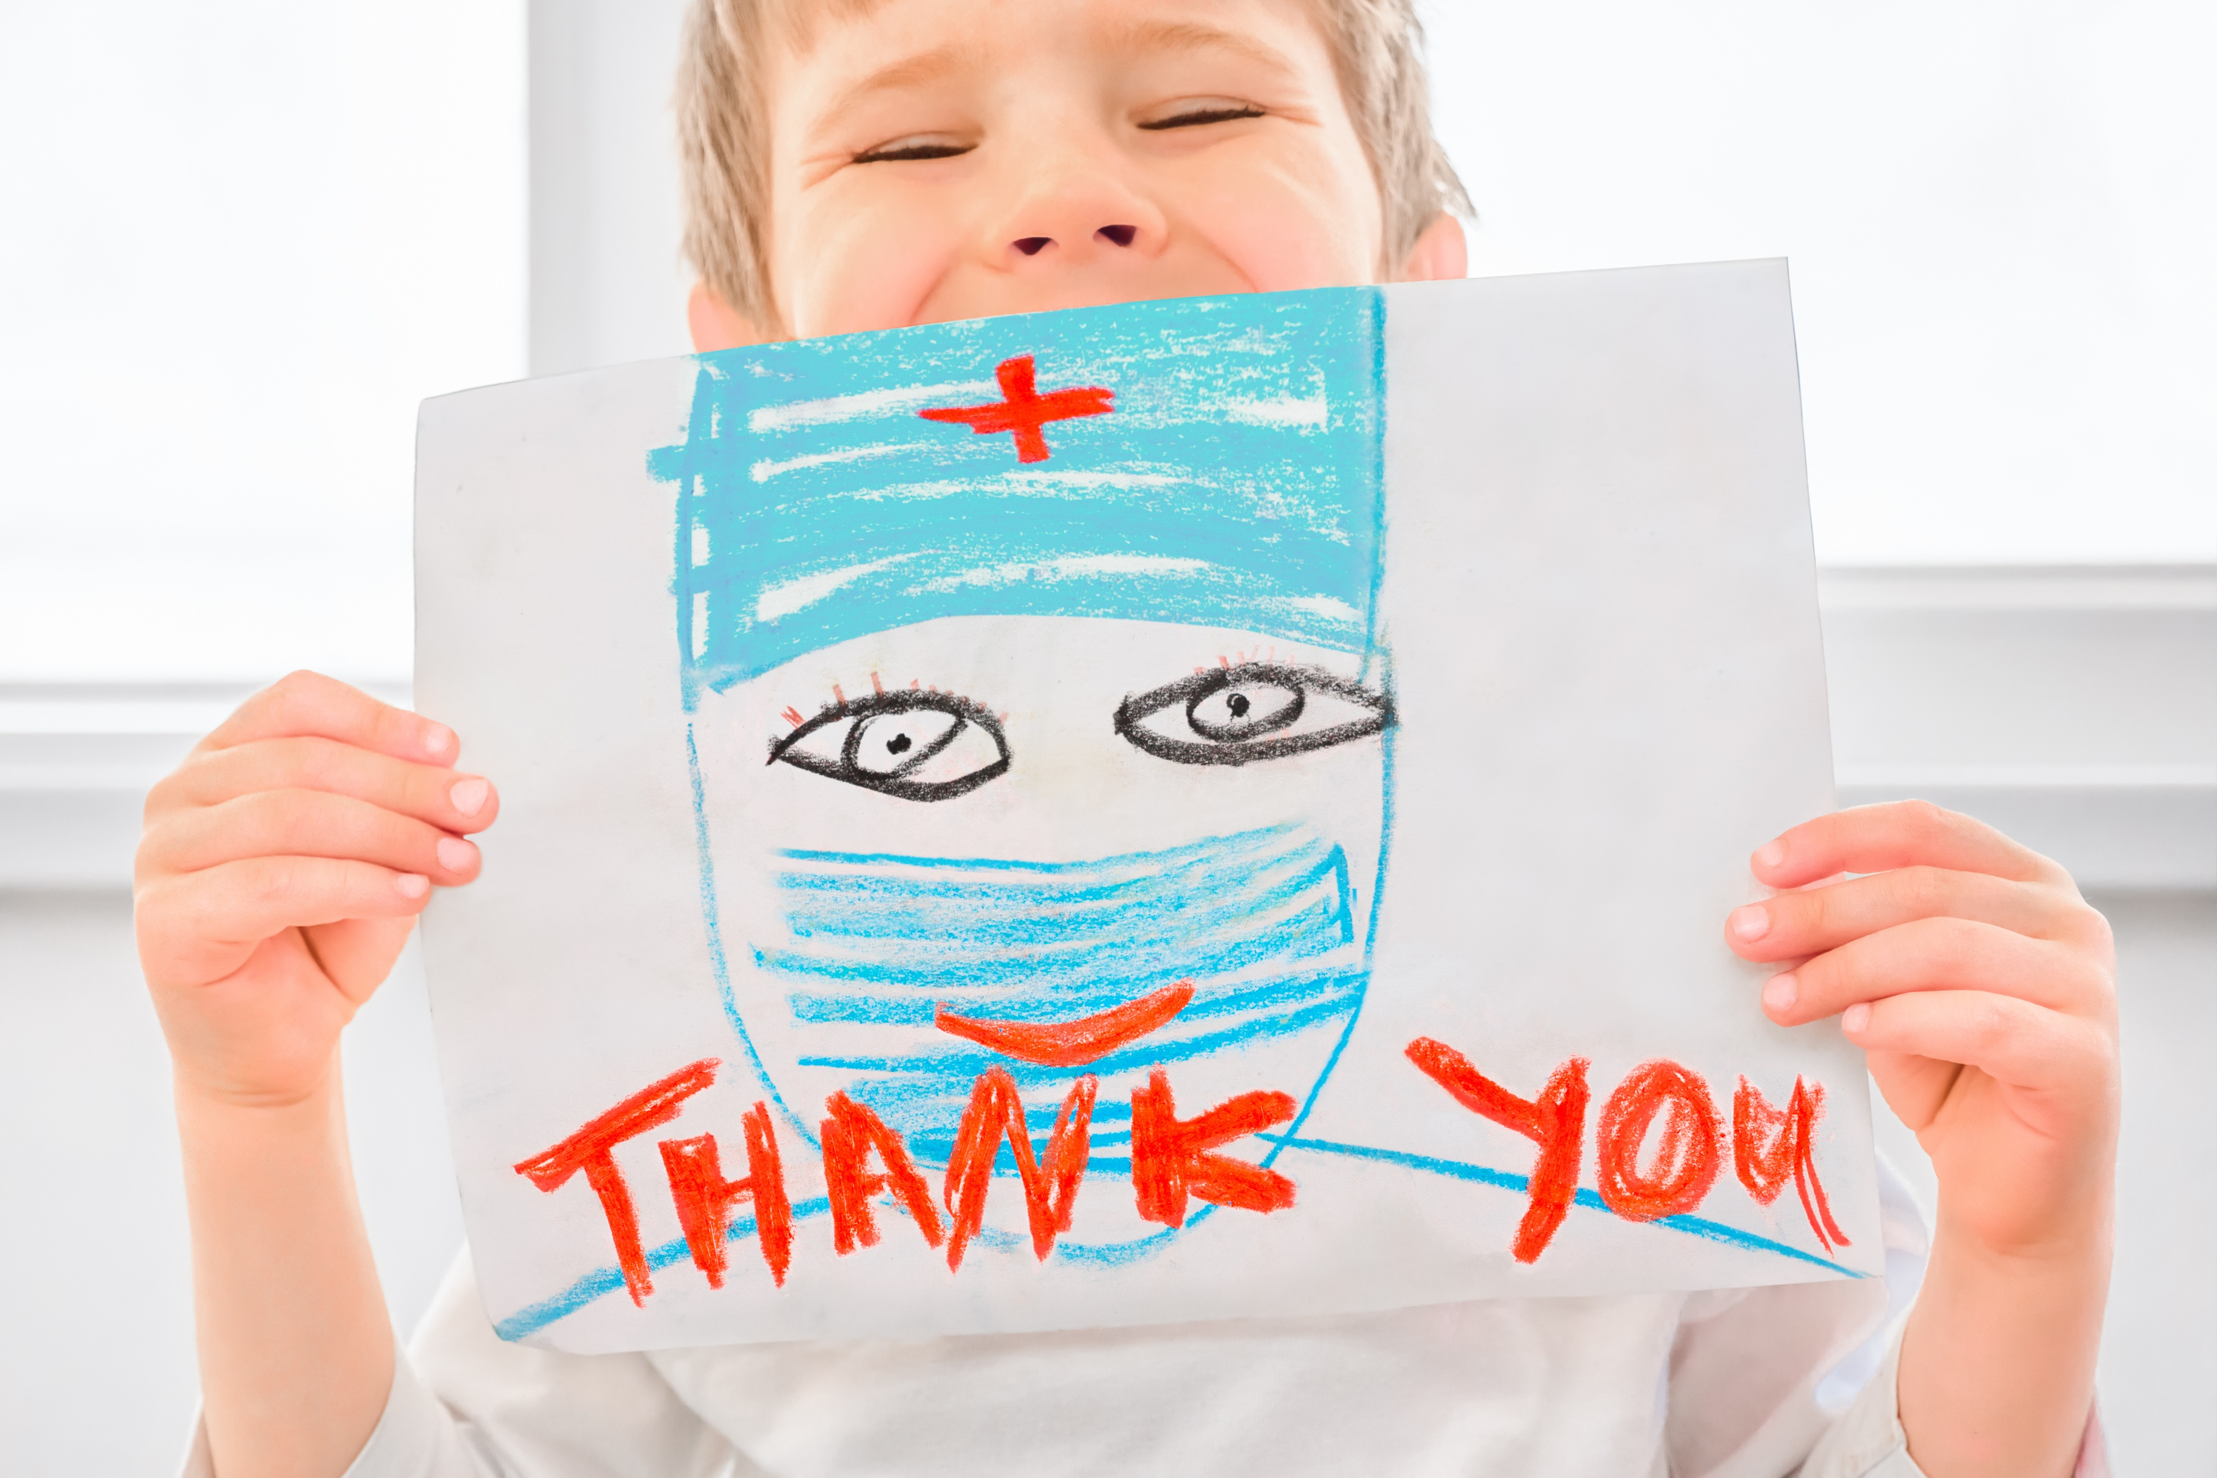
Story Sparks and Draw Your Rights
Story Sparks Activity
Story Sparks uses personal storytelling prompts to encourage pupils to share experiences improving health settings and fostering empathy.
Draw Your Rights Activity
Draw Your Rights invites pupils to express experiences visually with comics, posters, and infographics, supporting non-verbal communication.
Inclusive and Creative Feedback
Combining storytelling and art makes participation fun and inclusive, ensuring every child's voice contributes to health service improvements.
Notes:
Story Sparks and Draw Your Rights are activities that allow pupils to express their experiences and ideas through storytelling and art. Story Sparks uses prompts such as “A time I felt brave,” “A time play helped,” or “One small change that would help me,” encouraging pupils to share personal narratives that reveal what works and what needs improvement in health settings. These stories provide rich qualitative data for the National Health Rights Survey while fostering empathy and reflection among participants. Draw Your Rights invites pupils to create visual representations of their experiences, using comic strips, posters, or infographics. This activity is particularly effective for younger children or those who prefer non-verbal communication. By combining creativity with advocacy, these exercises make participation enjoyable and inclusive, ensuring that every child’s voice is heard. Teachers can collect and submit these outputs alongside survey responses, creating a comprehensive picture of children’s perspectives. Both activities emphasize that feedback is not just about ticking boxes—it’s about sharing real feelings and ideas that can drive meaningful change in health services.

Slide 19
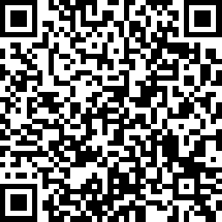
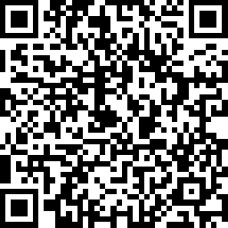
TAKE THE SURVEY
CHILDREN AND YOUNG PEOPLE
TEACHER/ TEACHING SUPPORT STAFF
Notes:
TAKE THE SURVEY
Children’s Link: https://www.surveymonkey.com/r/P9R5C5C
Teacher Link: https://www.surveymonkey.com/r/T87DS5N

Slide 20
SEND US WHAT YOU’VE DONE
Join our Health Rights Defenders.
Your class can get a Health Rights Defender Bear, Badge and Certificate.
EMAIL: CYPHRS@childrenshealthscotland.org
With your School Name, Area, Health Board and number of CYP who’ve taken part. Also, what year you are in.

