Slide 1


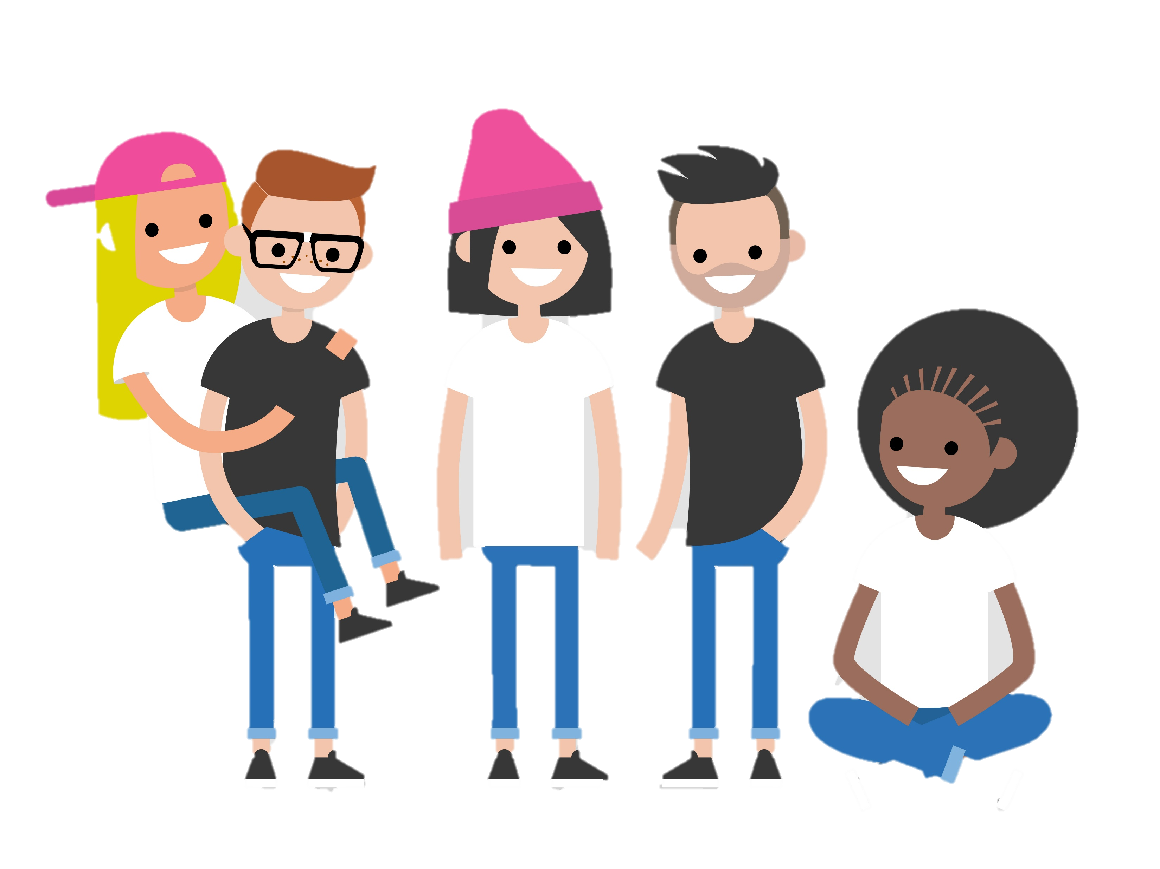



THE HEALTH RIGHTS POWER PACK
BECOME A HEALTH RIGHTS DEFENDER
Empowering individuals to protect the right of every child to the best possible health
With thanks to:

Slide 2
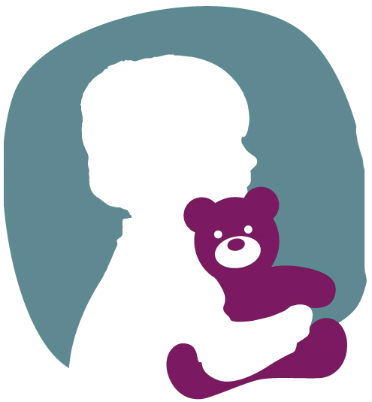
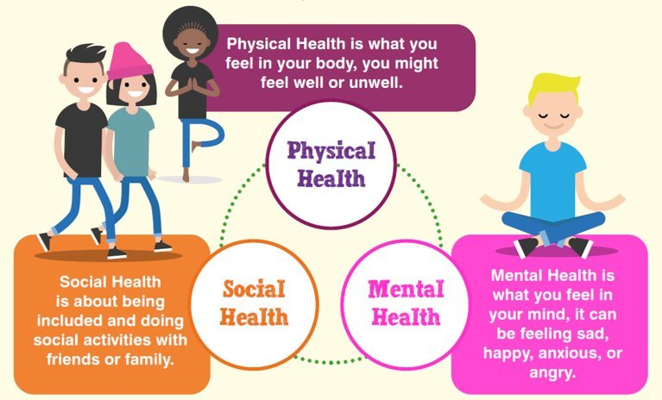
Notes:
World Health Organisation defines health as “a state of complete physical, mental ,and social wellbeing and not merely the absence of disease or infirmity“.​​
Children and Young People have a right to the best possible health under Article24 of the UNCRC.​​
The Each Charter protects Children and Young People’ rights in Healthcare

Slide 3
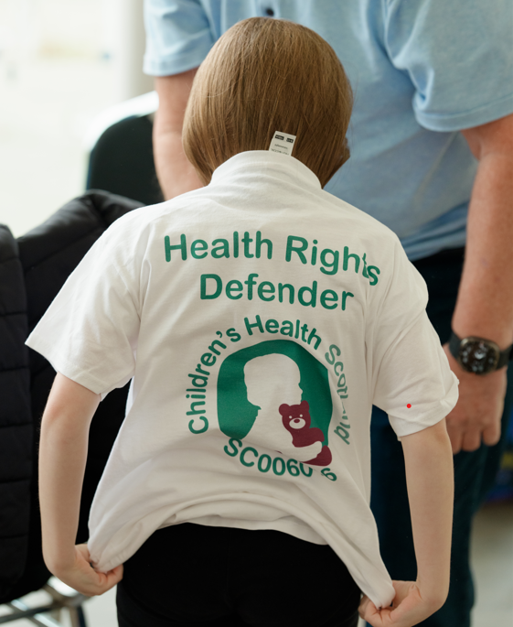
Welcome to the Power Pack
Empowering Health Rights Defenders
  The Power Pack transforms sessions to engage children in understanding and defending their health rights effectively.
Interactive Learning Methods
  Activities include emoji check-ins, scenario games, and creative prompts to make learning about health rights fun.
Support for Educators
  Structured scripts and activity menus help teachers guide sessions lasting 10 to 45 minutes.
Aligning with Rights Principles
  The approach reinforces the UNCRC and EACH principles and CHS commitment to rights-based, inclusive care.
Notes:
The Health Rights Power Pack is designed to transform school assemblies and classroom sessions into engaging, rights-focused experiences that empower children and young people to become Health Rights Defenders. This initiative supports Children’s Health Scotland’s Scotland’s National Health Rights Survey by encouraging pupils to share their voices through creative activities, games, and stories. The purpose of the pack is to make health rights tangible and fun, ensuring that every child understands their entitlements to safe, inclusive, and respectful care. It introduces key concepts such as the right to information, participation in decisions, access to play and education, and emotional support during health experiences. By using interactive methods like emoji check-ins, scenario-based games, and creative drawing prompts, the pack fosters confidence and advocacy skills among pupils. Teachers and facilitators can use the structured script and activity menu to guide sessions that last between 10 and 45 minutes, depending on the chosen activities. The ultimate goal is to gather authentic feedback for Children’s Health Scotland’s the National Health Rights Survey while reinforcing the importance of children’s voices in shaping health services. This approach aligns with UNCRC principles and CHS’s commitment to rights-based care, making participation meaningful and enjoyable for all age groups.

Slide 4
Your Mission
Understanding Health Rights
  Pupils learn that health rights include clear information, involvement in decisions, and inclusive care.
Emotional Check-In
  Session starts with an emoji-based emotional check-in to understand pupils' feelings about health support.
Creative Engagement Activities
  Activities like Build Your Health Rights Defender and Draw Your Rights encourage creative expression and collaboration.
Empowerment and Collective Action
  Pupils feel empowered to share their voices and contribute to improving health experiences nationally.
Notes:
The mission of today’s session is to inspire pupils to step into the role of Health Rights Defenders by exploring what health rights mean and how they can influence positive change. Pupils will learn that health rights include access to clear information, involvement in decisions, opportunities for play and learning even in hospital settings, and safe, inclusive care. The session begins with a quick emotional check-in using emojis to gauge feelings about health and school support, followed by an introduction to the concept of defenders—children who actively protect and promote health rights for themselves and others. Activities such as Build Your Health Rights Defender, Rights Quest, and Draw Your Rights allow pupils to express their ideas creatively and collaboratively. These exercises encourage them to identify what helps them feel safe and supported, what barriers they face, and what improvements they would like to see. By completing the short survey at the end, pupils contribute valuable insights that will inform national policy and practice. The mission emphasizes empowerment, creativity, and collective action, making every participant feel that their voice matters and that they are part of a nationwide movement to improve health experiences for all children.

Slide 5

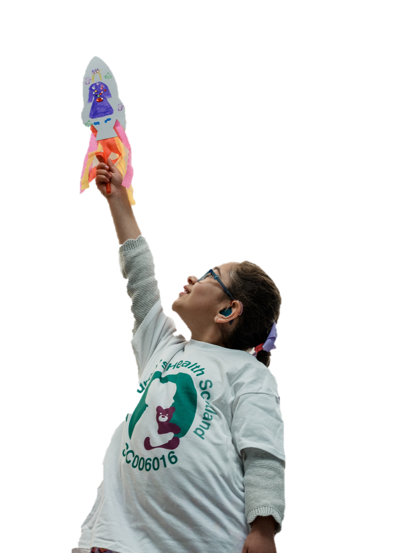

UNDERSTANDING YOUR HEALTH RIGHTS
Notes:
These slides are for your understanding on a deeper level on what children’s health rights are.

Slide 6
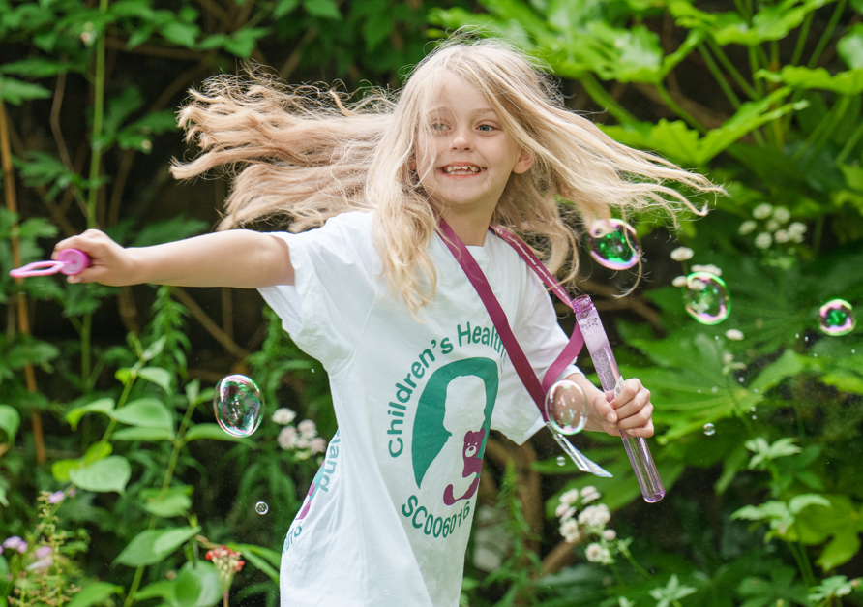
WHAT ARE HEALTH RIGHTS?
Educational Approach
  Teaching health rights in child-friendly ways enables pupils to recognize when rights are upheld or compromised.
Empowerment through Knowledge
  Understanding health rights helps children advocate for themselves, building confidence and resilience in healthcare settings.
Real-life Application
  Children learn to apply their rights by asking for clear information, playtime, and quiet spaces to reduce anxiety.
Fundamental Health Rights
  Children have rights to safe, respectful, and inclusive healthcare that meets their unique needs and backgrounds.
Notes:
Health rights are fundamental entitlements that ensure children receive care that is safe, respectful, and inclusive. These rights include the right to clear and age-appropriate information, the right to participate in decisions about their health, and the right to play and education even during hospital stays. They also encompass emotional support, privacy, and equal treatment regardless of background or ability. Understanding these rights empowers children to advocate for themselves and others, fostering confidence and resilience in health settings. In Scotland, these principles align with the UNCRC and national health policies, making them legally and ethically significant. By teaching pupils about health rights in a child-friendly way, schools help create informed individuals who can recognize when their rights are upheld or compromised. This knowledge is crucial for shaping services that meet the needs of all children, including those with additional support needs or care experience. Through interactive discussions and examples, pupils learn how rights translate into real-life actions, such as asking for clear explanations, requesting play opportunities, or seeking quiet spaces to reduce anxiety. This foundational understanding sets the stage for meaningful participation in the National Health Rights Survey.

Slide 7
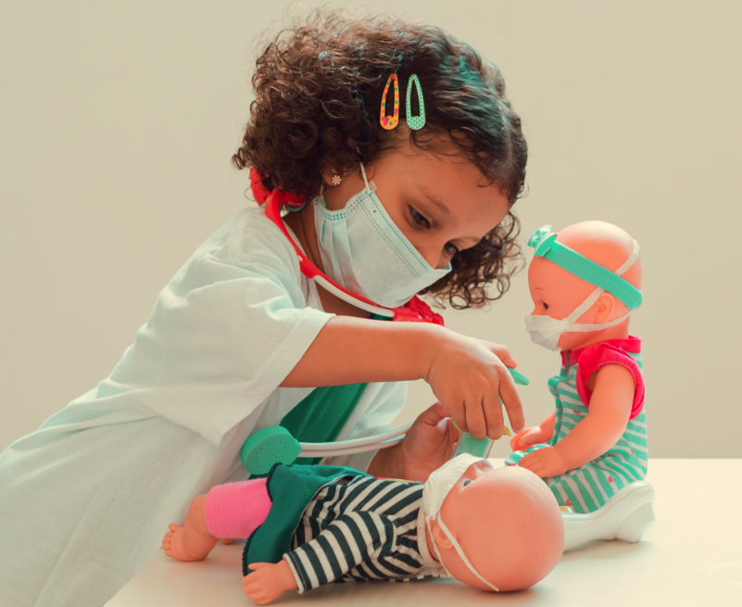
Why Children’s Health Rights Matter
Impact on Wellbeing
  Health rights influence a child’s physical, social, mental, and educational wellbeing positively, reducing anxiety and improving health outcomes.
Right to Information
  Children who understand their rights can ask for simple explanations, reducing fear during medical procedures.
Child Involvement and Feedback
  Involving children in healthcare decisions builds trust and improves treatment. While feedback (like this survey) identifies service gaps.
Inclusive Care and Play
  Access to play and education in hospitals supports mental health and ensures equitable care for children with special needs.
Notes:
Health rights matter because they directly impact a child’s physical, social, mental, and educational wellbeing. When children understand and exercise their rights, they experience greater confidence, reduced anxiety, and improved health outcomes. For example, a child who knows they have the right to information can ask for explanations in simple language, reducing fear during medical procedures. Similarly, access to play and education in hospital settings helps maintain normalcy and supports mental health. Rights-based care also ensures that children with disabilities, chronic conditions, or care experience receive equitable treatment tailored to their needs. Involving children in decisions fosters trust and collaboration between families and healthcare providers, leading to better adherence to treatment plans and overall satisfaction. Moreover, collecting feedback through initiatives like the National Health Rights Survey helps identify gaps in service delivery, such as lack of quiet spaces or insufficient emotional support. By highlighting these issues, CHS can advocate for systemic improvements that benefit all children. Ultimately, health rights are not abstract concepts—they are practical tools that empower children to shape their experiences and contribute to a culture of respect and inclusion in healthcare.

Slide 8
SEND US WHAT YOU’VE DONE
Join our Health Rights Defenders.
Your class can get a Health Rights Defender Bear, Badge and Certificate.
EMAIL: CYPHRS@childrenshealthscotland.org
With your School Name, Area, Health Board and number of CYP who’ve taken part. Also, what year group you are you teaching.

